Slide 1
Meeting will be starting soon.
Thank you for your patience,
Mahalo!

Slide 2
Reminders
Please change your name to First, Last Initial, Organization (if applicable).
If you’ve called in via phone, merge your audio and video.
Make sure you’re using “Grid View” within “Layout” in the top right corner.
If you feel comfortable, turn on your camera. A recording will be uploaded to the PUC Youtube.
If you’re having tech issues, click on “Chat,” select “Direct” messages, and choose “Hawaii Public Utilities Commission” in the search field.
To Raise your Virtual Hand to speak: Click on “Raise Hand” in your tool bar at the bottom, using the icon that looks like a raised hand.
This meeting will be recorded.
2

Slide 3

Electricity Disconnections
Meeting #3
Energy Equity and Justice
Docket No. 2022-0250
March 5, 2025 | 10am - 12pm

Slide 4
ʻAʻohe hana nui ke alu ʻia.
"No task is too big when done together."
This phrase reminds us that solutions are not found in isolation. It is through collaboration—between policymakers, researchers, advocates, and communities—that we can build a more just and equitable energy system."

Slide 5
Agenda
Welcome & Meeting Overview
Presentation from
  Energy Justice Lab at Indiana University
  Fresh Energy
  California Public Utilities Commission
  Massachusetts Attorney General’s Office
  University of Pennsylvania, FSC, Public Finance and General Economics of Belmont, Massachusetts
Questions for Presenters
Closing & Next Steps

Slide 6
Logistical Notes
Commission staff will take notes during this meeting. Statements recorded in the notes will not be attributed and will be filed to the docket record.
This meeting is being recorded. The recording will be made publicly available on the Commission’s YouTube.
Please reach out to Alika Luague (alika.j.luague@hawaii.gov) if you are having any technical difficulties.

Slide 7
Meeting Norms
Practice democracy of time.
Consider new possibilities and push the envelope.
Respect and appreciate others’ unique and lived perspectives.
Utilize the “bike rack” to park useful insights outside today’s scope.

Slide 8
Welcome & Meeting Overview
Disconnection has been a concern of the Energy Equity and Justice Docket since its inception
  S.C.R. 48 noted protecting households from disconnections as among the issues the Commission should examine
  The Commission enacted disconnection moratoriums during the Covid-19 pandemic in 2020 and for Maui after the wildfire
  The PUC asked RMI to explore disconnections in Hawaii and policies enacted elsewhere. The report was shared in the docket on August 14, 2024
  The first disconnection meeting was held on October 22, 2024 – featuring Hawaiian Electric, Kauai Island Utility Cooperative (KIUC), and the Division of Consumer Advocacy as speakers. The second disconnection meeting was held on December 9th, 2024 where we gained insights from community-based organizations that directly support individuals facing disconnection notices.
Today’s meeting is to help us all learn more about best practices, policy solutions, and research-driven strategies to address utility disconnections

Slide 9
Presentation #1:
Dr. Sanya Carley & Dr. David Konisky
Energy Justice Lab (Indiana University & University of Pennsylvania)
Sanya Carley is a Presidential Distinguished Professor of Energy Policy and City Planning at the Stuart Weitzman School of Design and the Mark Alan Hughes Faculty Director of the Kleinman Center for Energy Policy at the University of Pennsylvania. She co-directs the Energy Justice Lab and is a University Fellow at Resources for the Future. Her research focuses on energy justice, electricity and transportation markets, and public perceptions of energy infrastructure and technologies.
David M. Konisky is the Lynton K. Caldwell Professor of Environmental Studies and Associate Dean for Research at the O’Neill School of Public and Environmental Affairs at Indiana University, Bloomington. Konisky also is the Co-Director of the Energy Justice Lab. His research and teaching focus on environmental policy and politics, the U.S. energy transition, policy implementation, and public opinion.

Slide 10

Energy Insecurity and Utility Disconnections
Sanya Carley
Presidential Distinguished Professor of Energy Policy and City Planning
Mark Alan Hughes Faculty Director
Kleinman Center for Energy Policy
University of Pennsylvania
David Konisky
Lynton K. Caldwell Professor
Co-Director, Energy Justice Lab
O’Neill School of Public and Environmental Affairs
Indiana University, Bloomington

Slide 11

Each year in the United States, over one in four households experience energy insecurity
Source: Energy Information Administration, 2020. Residential Energy Consumption Survey.

Slide 12
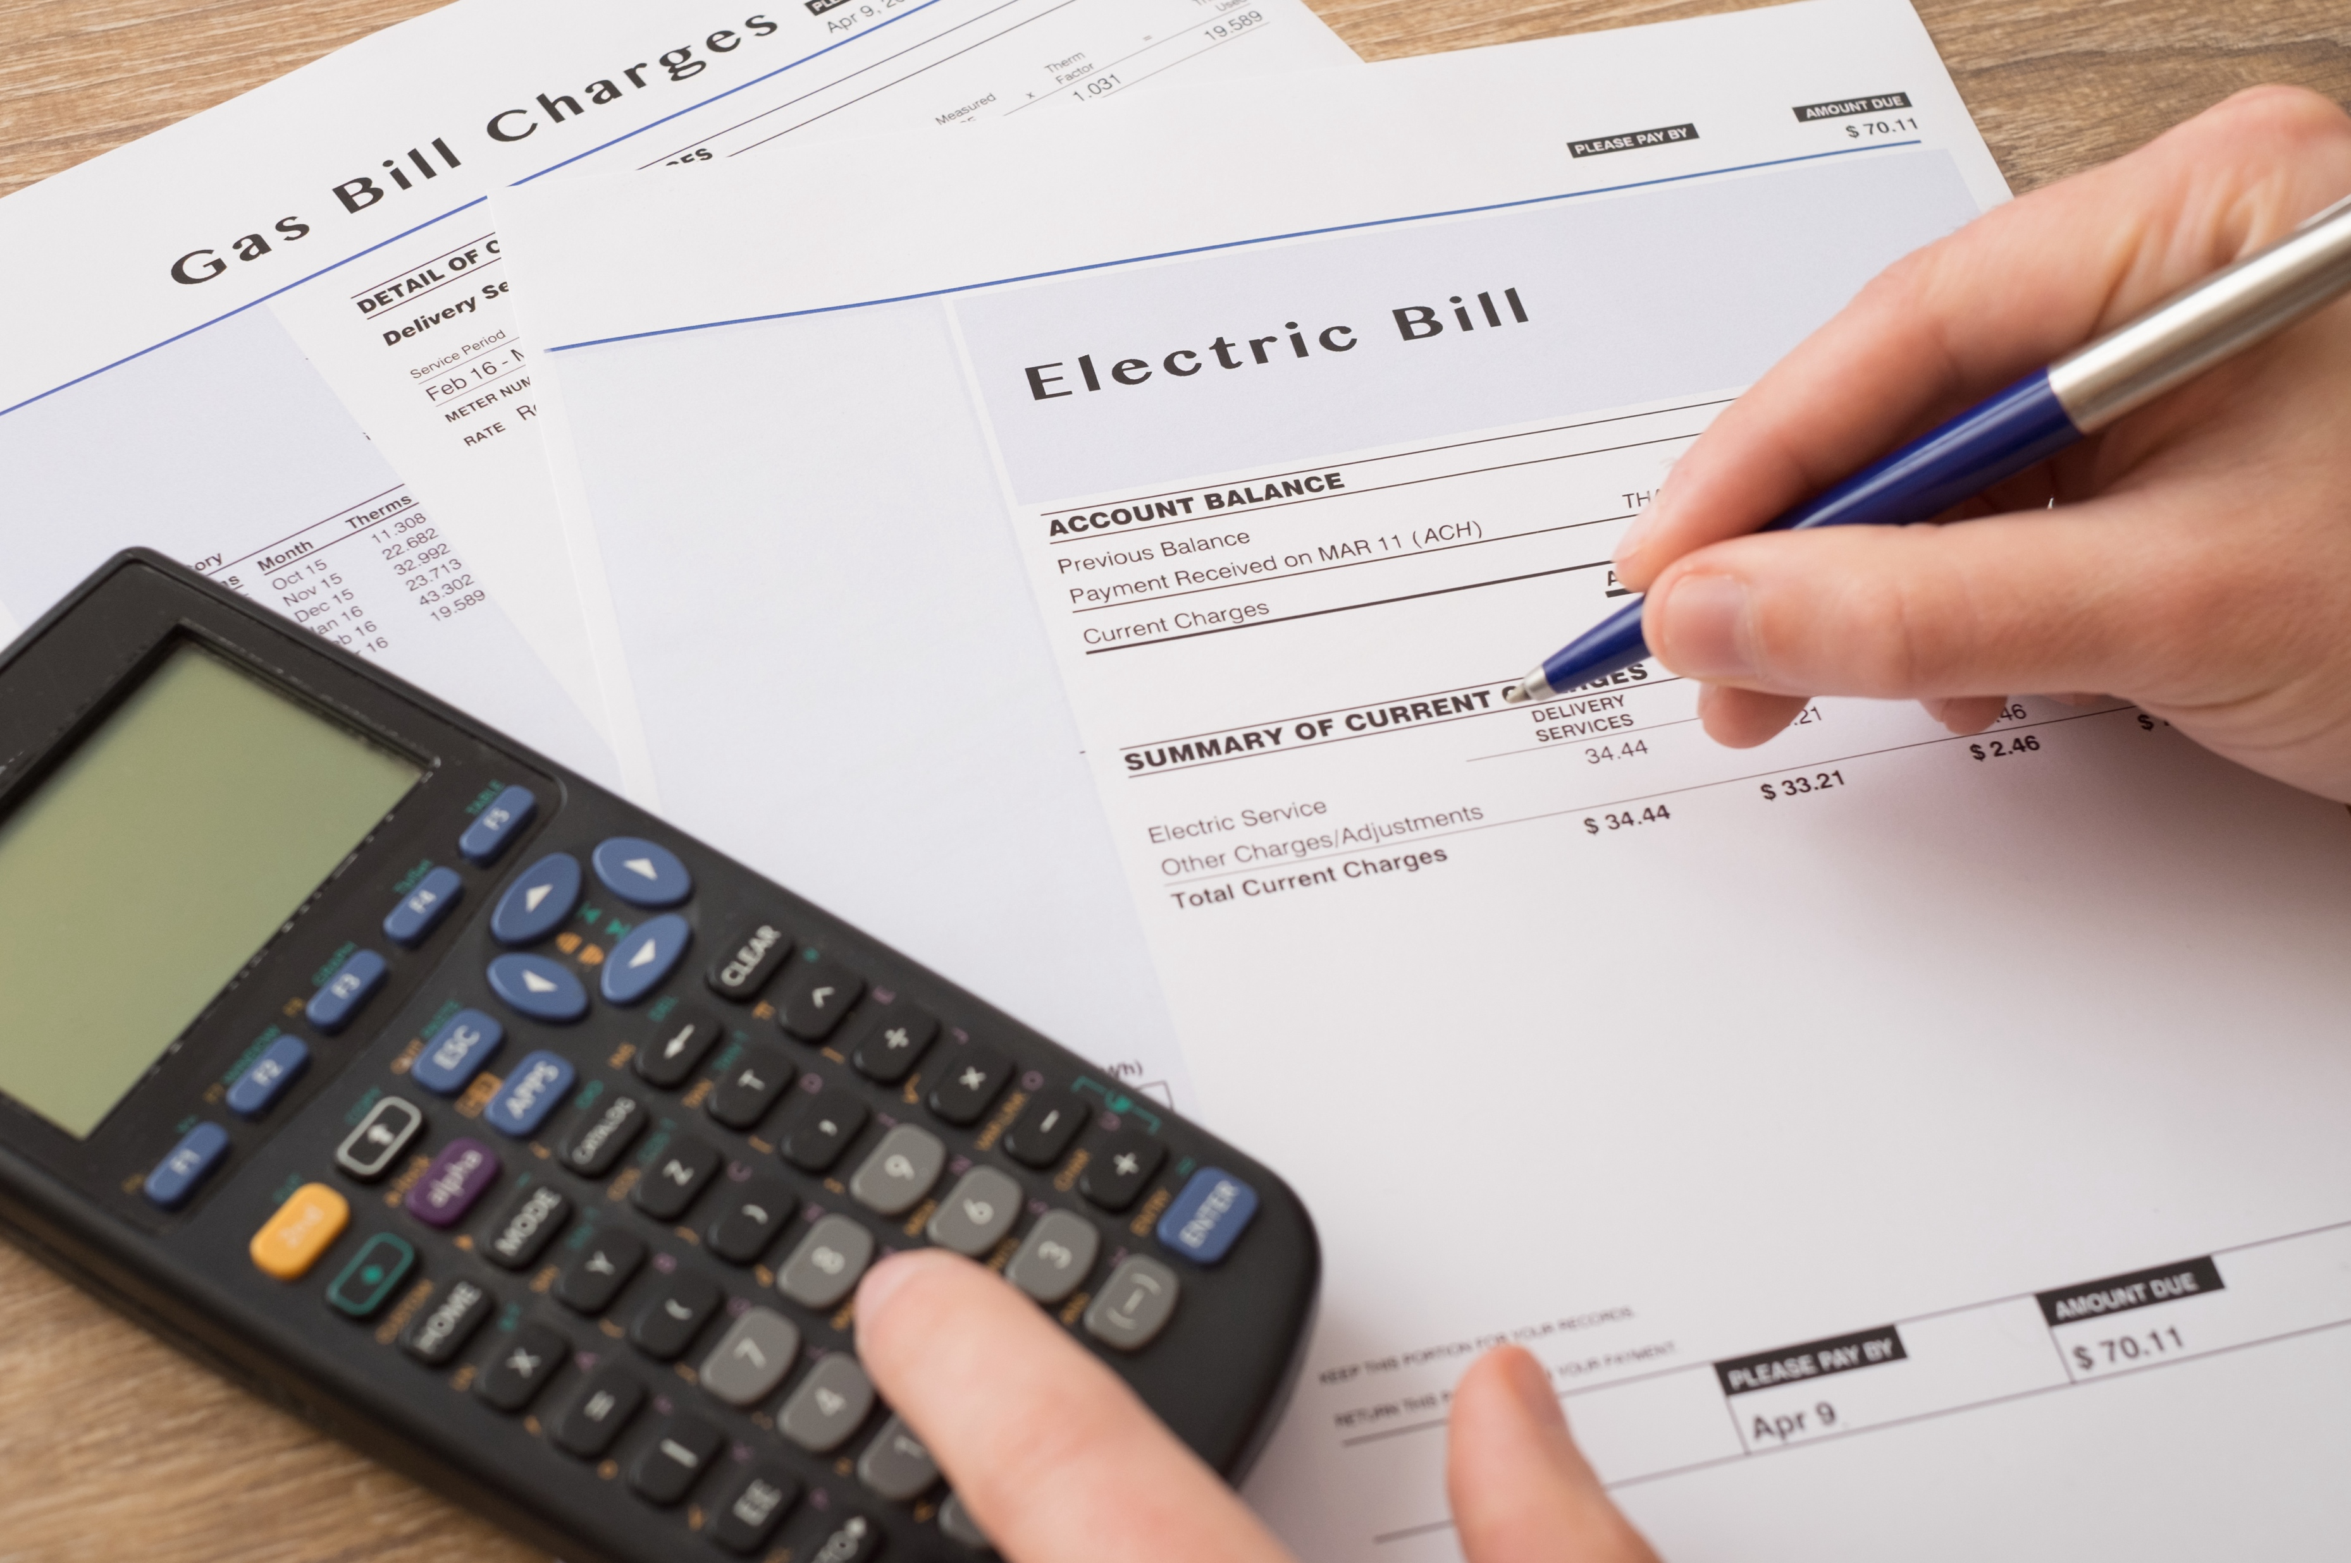
How many households get disconnected?
In 2023, ~2 million households had their electricity or natural gas shut off due to nonpayment of their monthly utility bill
In 2024, Hawaii’s utilities disconnected about 15,000 residential customers
Source: Energy Justice Lab, Utility Disconnections Dashboard (https://utilitydisconnections.org)

Slide 13






Without Power
13

Slide 14







Who is disconnected most often?
Households of color
Children under 5 years old
Electronic medical devices
Poor housing conditions
Source: Memmott, Carley, Graff, Konisky. 2021. Socioeconomic disparities in energy insecurity among low-income households before and during the COVID-19 pandemic. Nature Energy 6, 186-193
Source: Konisky, Carley, Graff, Konisky. 2022. The persistence of household energy insecurity during the COVID-19 pandemic. Environmental Research Letters.
Source: Memmott, Konisky, Carley. 2024. Assessing demographic vulnerability and weather impacts on utility disconnections in California. Nature Communications 15.

Slide 15
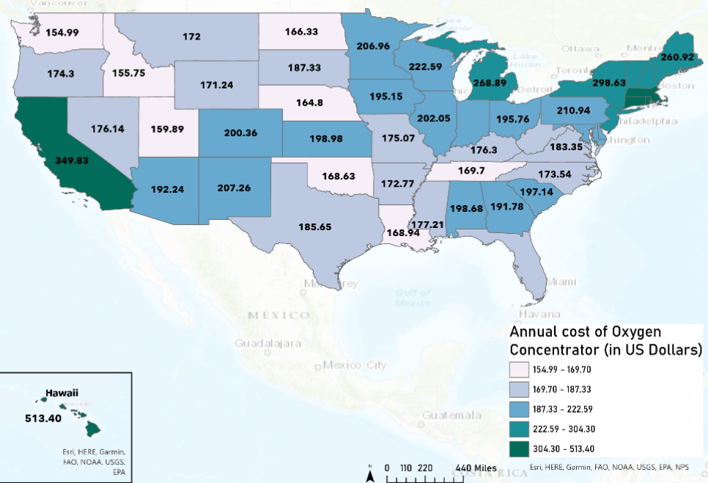

Durable medical equipment (DME) can significantly increase bills
Source: Carley, Bansal, Harak, Kahn, Konisky, Simon. The electricity cost burden of durable medical equipment in the United States. Scientific Reports 14.

Slide 16


Weather patterns increase disconnections
Source: Memmott, Konisky, Carley. 2024. Assessing demographic vulnerability and weather impacts on utility disconnections in California. Nature Communications 15.

Slide 17
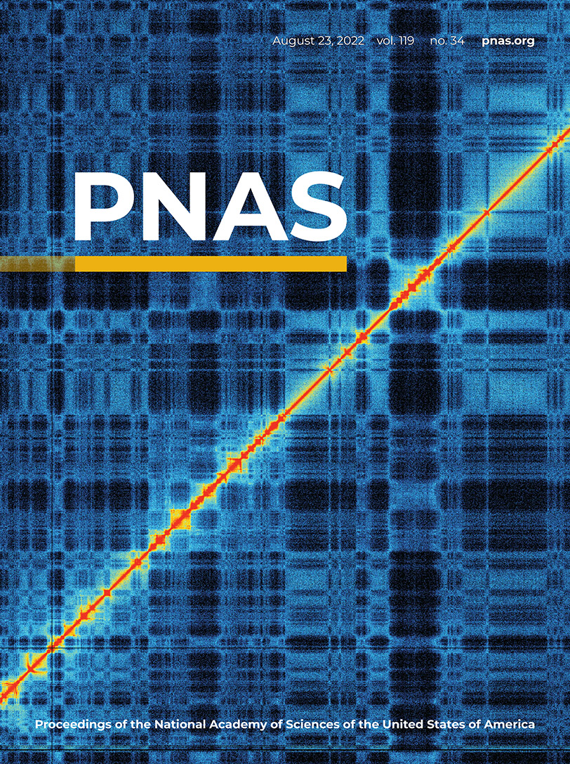
How do households cope?
Source: Carley, Graff, Konisky, Memmott. 2022. Behavioral and financial coping strategies among energy insecure households. Proceedings of the National Academy of Sciences.

Slide 18
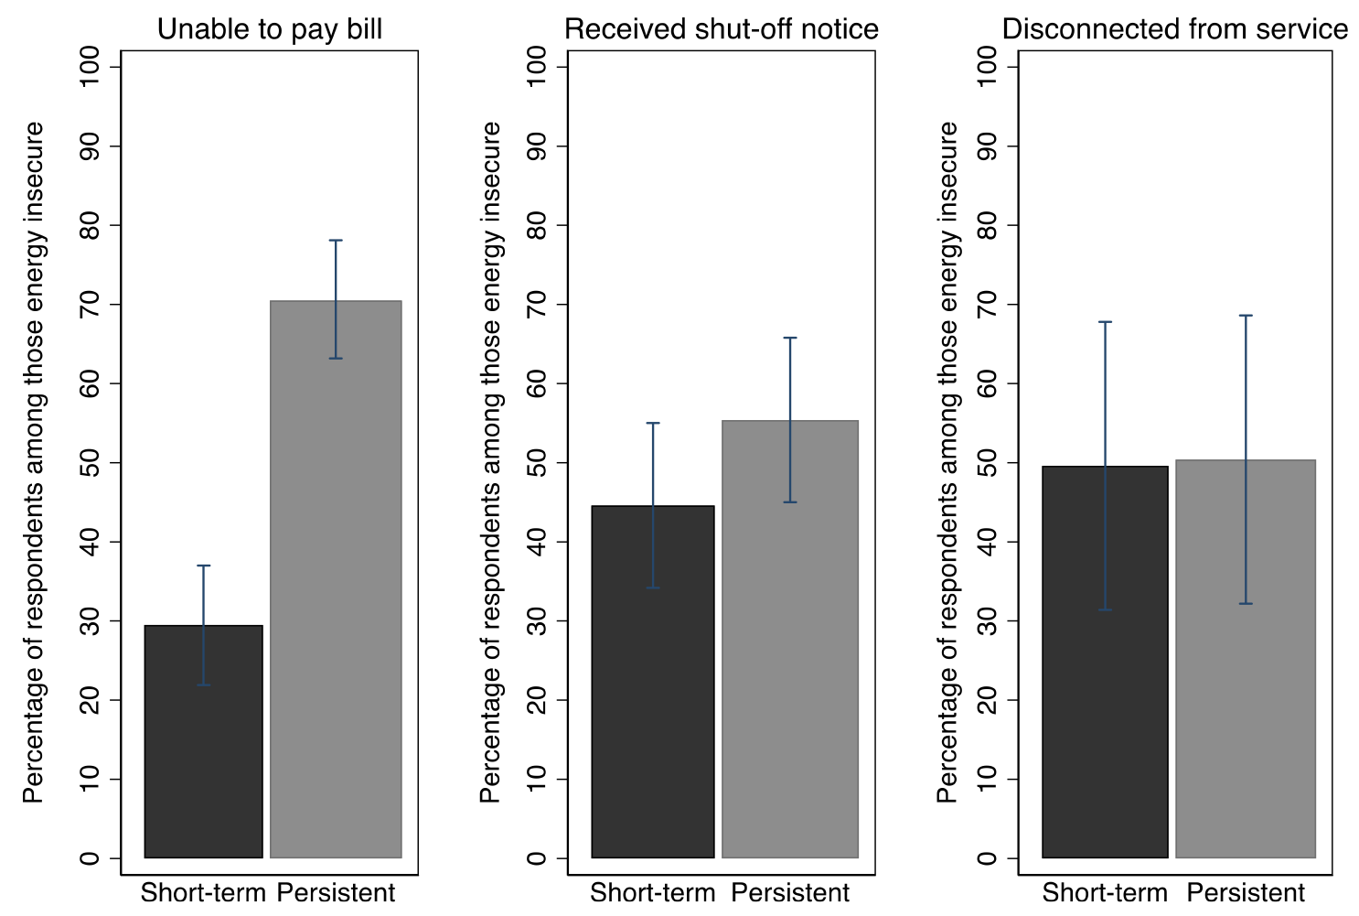
Energy insecurity is reoccurring for more than half of those who experience it
Source: Konisky, Carley, Graff, Konisky. 2022. The persistence of household energy insecurity during the COVID-19 pandemic. Environmental Research Letters.

Slide 19
Energy insecurity is reoccurring for more than half of those who experience it
Struggle to pay bills
Shutoff
Shutoff + other fees
Struggle to pay bills
Shutoff
Source: Konisky, Carley, Graff, Konisky. 2022. The persistence of household energy insecurity during the COVID-19 pandemic. Environmental Research Letters.

Slide 20
Points of policy intervention or assistance
Discounted utility rates: lifeline discount model & tiered discount model
Budget utility billing (“smoothed billing”)
Arrearage management plan (AMP)
Percentage-of-income payment plan (PIPP)
Household struggles to pay energy bill
Household receives notice for disconnection
Household is disconnected
Utility prepayment (pay-per-use)
Weatherization (WAP), Energy Efficiency, Customer-Owned or Community Shared Distributed Generation, Smart Gadgets
Bill assistance (LIHEAP and others)
Debt Relief
Disconnection Protections, Debt Relief

Slide 21
Utility disconnection protections
Source: Energy Justice Lab, Utility Disconnections Dashboard

Slide 22



Disconnection protections: Opportunities for enhancement by utilities
Clearly specify minimum days of notice prior to disconnection + provide multiple forms of notice
Establish date-range when customers can pay bills before being considered late or delinquent
Provide information to customers on promotions at least twice annually
Source: Carley, S.; Konisky, D.M.; Nash, E. 2023. Electric Utility Disconnections: Legal Protections and Policy Recommendations.

Slide 23







Disconnection protections: Opportunities for enhancement by government
Broad definitions of medical conditions & delays for utilities requiring certificates
Easily understood and transparent language with few administrative burdens
Combined temperature & date-based protections
Tenants should not suffer disconnection due to their landlord’s failure to pay the building’s utility bills
Protections for households with children, elderly, or people with disabilities
Establish a minimum arrearage before disconnections occur
Source: Carley, S.; Konisky, D.M.; Nash, E. 2023. Electric Utility Disconnections: Legal Protections and Policy Recommendations.

Slide 24
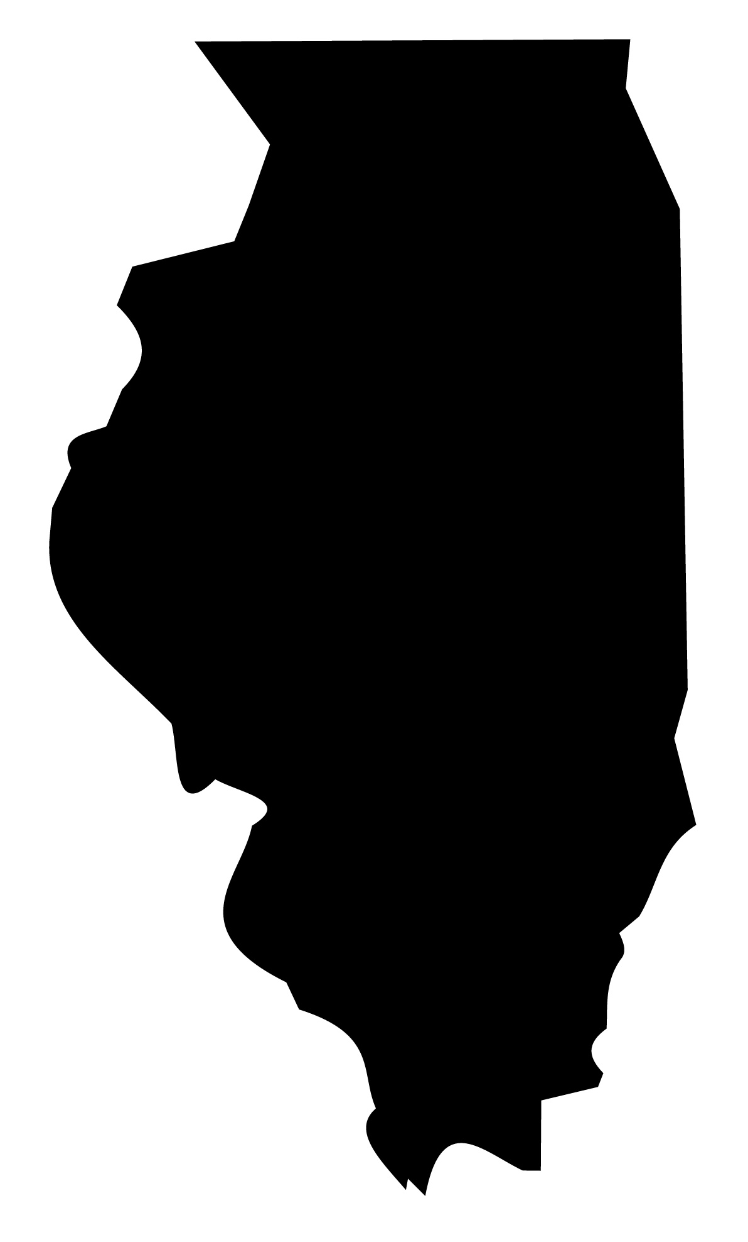
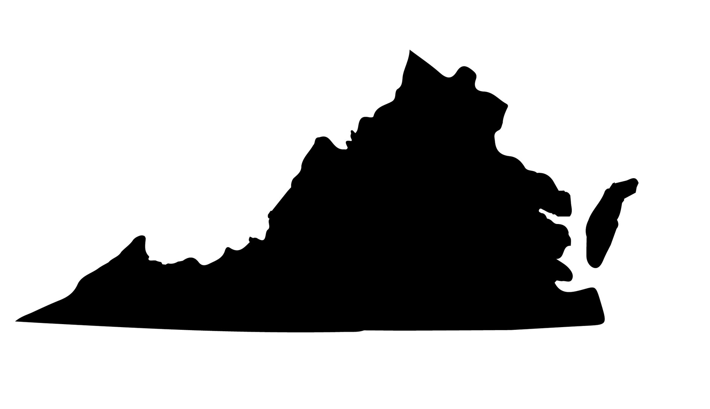
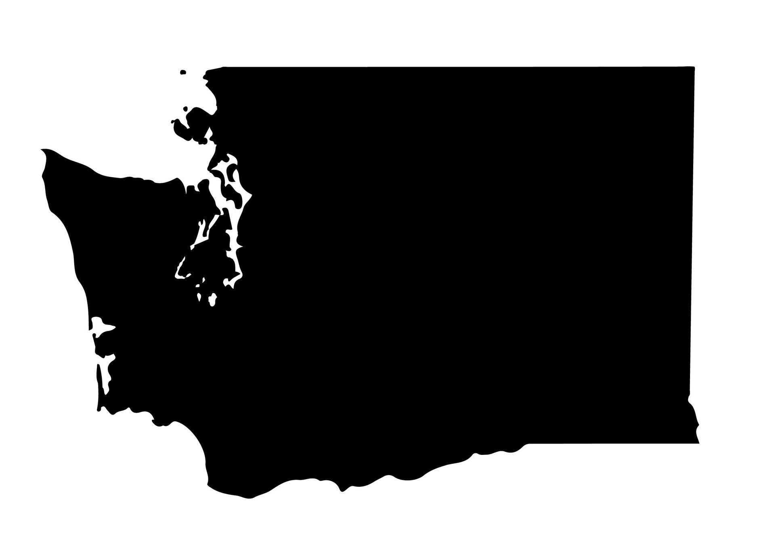
Recent state policy updates
ILLINOIS
VIRGINIA
WASHINGTON
Strengthened heat protections to prohibit shut-offs when forecasted temperatures of 90F or above
Effective January 1, 2024
Created first ever protections to prohibit shut-offs when temperatures are 32F or below, or 92F or above and on Fridays, weekends, and state holidays
Effective July 1, 2024
Added heat protections to prohibit shut-offs when there is a heat alert
Effective July 23, 2023

Slide 25

Can solar reduce incidence of energy insecurity?
In 2023, sent a survey to low-to-moderate households
Compare self-reported energy insecurity among a matched sample:
Solar Households
Non-Solar Households
vs.
Households who adopted in 2021 with the lowest estimated income*
Households that are similar on mean observable characteristics⁺
Yozwiak, Barbose, Carley, Montanes, Forrester, Konisky, Memmott, O’Shaughnessy, 2025. The effect of residential solar on energy insecurity among low- to moderate-income households. Forthcoming in Nature Energy.
Data:
*Tracking the Sun, Experian
⁺Core Logic (housing), Experian (income), ”wru” algorithm (race)

Slide 26
We find that those with solar are:

Slide 27
Summary Findings
Energy insecurity—and utility disconnections—is a pervasive problem, affecting millions of American households
  Uneven incidence
  Cyclical incidence
  Dangerous alternatives
Certain conditions worsen energy insecurity (e.g., inefficient or non-weatherized homes, use of DME, extreme weather)
Policy and other solutions include preventative efforts, short-term relief, and protections
  Evidence of efficacy of some preventative measures
  There are many ways that states can improve and expand disconnection protections, and several have taken positive steps in recent years

Slide 28
Presentation #2:
Shubha Harris
Equitable Energy Policy Consultant, Fresh Energy
Shubha Harris is an Equitable Energy Policy Consultant at Fresh Energy, focusing on equity and affordability in regulatory dockets before the Minnesota Public Utilities Commission and in state legislation. Previously, she was a Regulatory Attorney at Xcel Energy, where she represented the company on distribution, service quality, and performance-based ratemaking issues while co-leading an Equity Stakeholder Advisory Group. With a background in law, public service, and education, Shubha has worked for U.S. Senators Mark Dayton and Amy Klobuchar, clerked for the U.S. District Court of Minnesota and the Ninth Circuit Court of Appeals, and is a former Teach for America educator.

Slide 29

Pilot to automatically reduce energy burden
By: Shubha Muralidhara Harris
Equitable Energy Policy Consultant
Fresh Energy

Slide 30
Goal of equity stakeholder group
In 2021, the Minnesota Public Utilities Commission ordered Minnesota’s largest IOU, Xcel Energy, to create an Equity Stakeholder Advisory Group.
Purpose was to increase representation of diverse communities and explicitly center the voices of BIPOC communities.
Increase awareness of and participation in energy decision-making.

Slide 31
Who represented?
Broad range of organizations included; approximately 35 organizations. Several community-based organizations (more on the ground type organizations) and several traditional intervenors (e.g., ratepayer advocates, low-income solar advocates).

Slide 32
Priority setting
    Company does not set the agenda; equity stakeholder group sets the agenda.
    Language of order used “advisory” group as opposed to typical stakeholder group.

Slide 33
Priority development and outcomes
Reduce energy burden for low-income and BIPOC customers. This later divided into parallel efforts to reduce bills and to enhance access to energy efficiency.
Diversify the energy workforce and increase opportunities for people of color to participate in the clean energy economy.
Provide equitable access to renewable energy and its benefits.

Slide 34
LIHEAP quick facts
  Approximately 30 million households in the Unites States are eligible; however, only 20% of those eligible actually receive assistance (varies from state to state but 20% is the average enrollment).
  That means approximately 80% of people in need are not receiving LIHEAP assistance.

Slide 35
WHY is LIHEAP enrollment so low?
  LIHEAP generally requires an application process.
  Application process creates numerous barriers:
      Awareness of assistance.
      Complexity of application process.
      Verifying income/reviewing and approving application takes time and administrative resources.
      Stigma associated with applying for assistance.
      Customers often required to reapply each year or every two years.

Slide 36
Utility assistance programs
  Ratepayer funds, voluntary contributions and/or shareholder funds can offer additional monetary assistance.
  But often requires LIHEAP eligibility, application process, and re-applying.
  Pool of customers receiving utility assistance programs same as those receiving LIHEAP – 20% of eligible customers.
  Creates problem of only those capable accessing resources.
  Hardest to reach left further behind.

Slide 37
Xcel Energy Automatic Bill Credit Pilot Petition
    Pilot eliminates the need for an application.
    Uses available maps + census data showing areas of extremely high poverty and/or energy burden.
    Petition filed at Minnesota Public Utilities Commission in February 2024; Petition approved in October 2024.

Slide 38
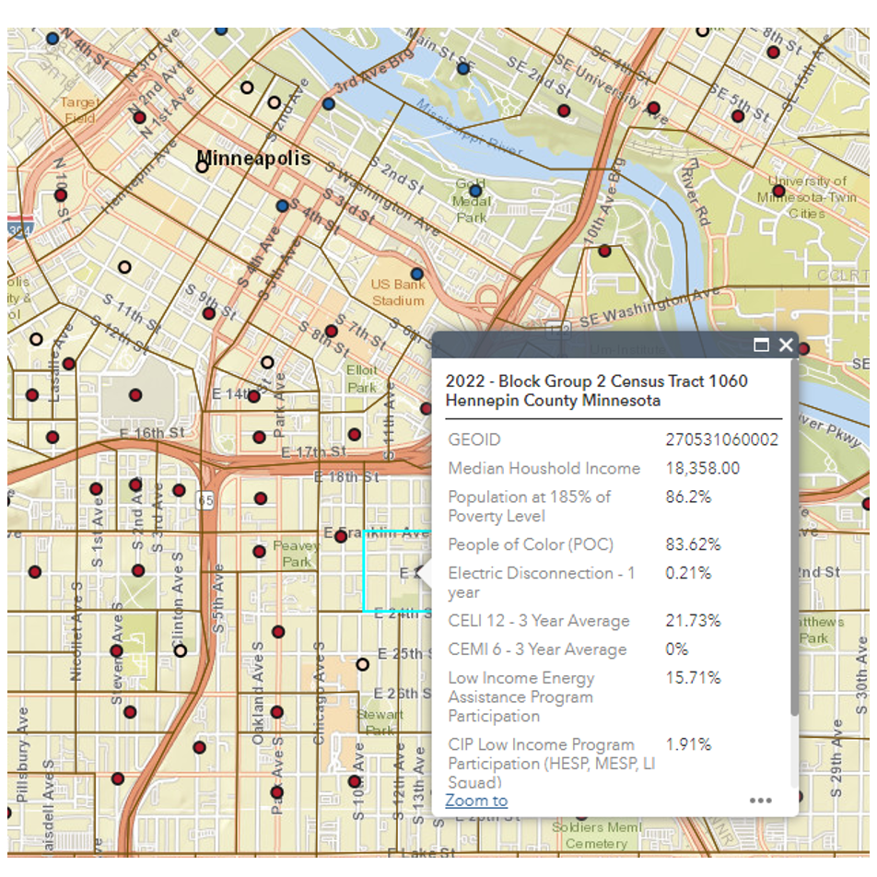
Automatic Bill Credit Cont’d

Slide 39
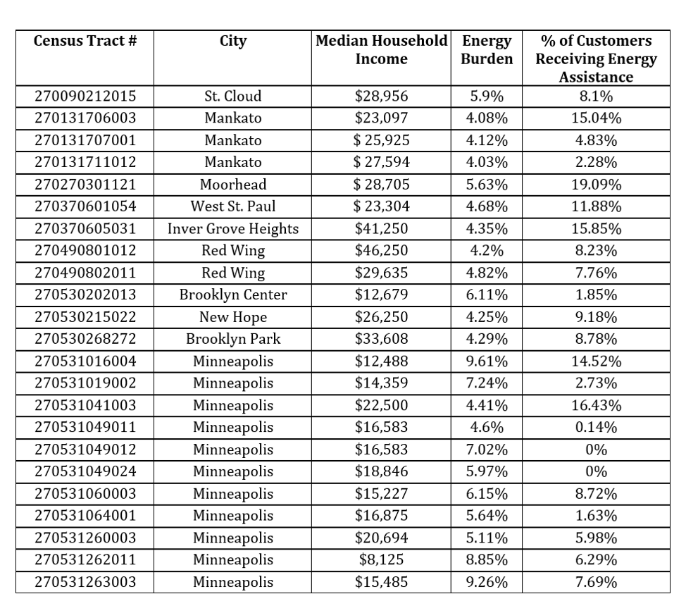
Automatic Bill Credit Cont’d

Slide 40
Details of pilot
    Automatic bill credit to all residential premises in census block groups (CBGs) where electric energy burden is above 4%. The bill credit will vary by CBG to reduce electric energy burden to 4%.
    No application, no enrollment requirements. Extremely small administrative costs.
    Approximately 17,000 premises in more than 60 CBGs will receive the automatic bill credit. Average bill credit is $240 per year.
    Total cost of pilot approximately $5 million.

Slide 41
Presentation #3:
Paul Phillip
California Public Utilities Commission
Program Supervisor, Electric Rate Design and Demand Flexibility, Energy Division
Paul oversees the Electric Rate Design section of the CPUC Energy Division, developing statewide pricing strategies, dynamic pricing programs, and the CalFUSE framework. His career includes work in climate strategies, renewable procurement, market development, and energy policy advising. He holds an MPA from Harvard Kennedy School and a BA in Economics and English Literature from UCLA.

Slide 42

California's Efforts to Reduce Disconnections
and Address Mounting Arrearages
Hawaii PUC Presentation
Paul Phillips | Retail Rates, Energy Division
March 5, 2025

Slide 43
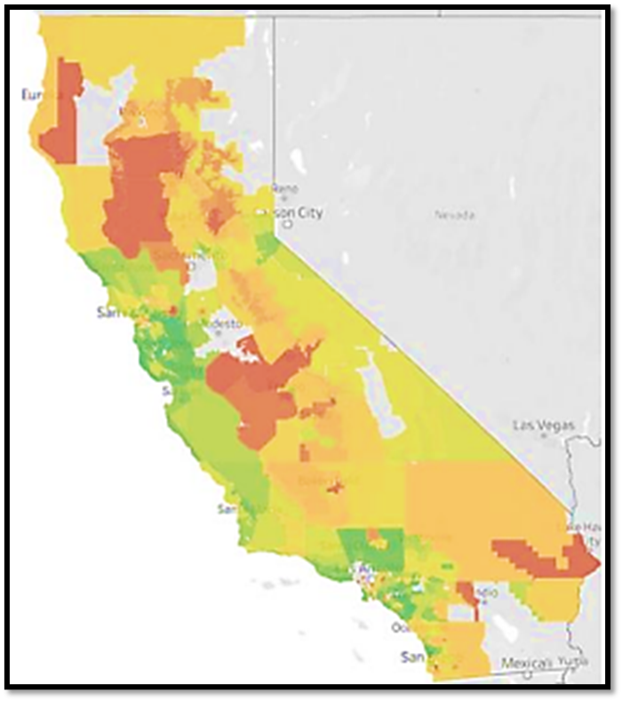
California Electric Rates and Affordability: “A Tale of Two States”
Coastal, cooler-to-moderate climate zones
  Wealthier homeowners
  Higher Net Energy Metering (NEM) i.e., rooftop solar + storage adoption rates to offset monthly bill
  Higher Electric Vehicle (EV) adoption rates and more rate choices such as electrification rates to reduce bill impacts
Inland, hotter climate zones
  Greater affordability issues
  Greater air conditioning needs resulting in greater average kilowatt-hour usage per month
  Fewer resources to invest in solar + storage, yet more likely to pay more for service due to cost shifts from those who do invest
What’s the narrative for the next several years?
  Rates will continue to outpace inflation over the next few years due primarily to wildfire-related costs and NEM, although the new Net Billing Tariff (NBT) for rooftop solar should slow this increase somewhat.
  EV sales momentum + greater electrification should lead to lower household energy costs for all--not just EV owners--but not during the period covered by the 2024 SB 695 Report (through 2027).
Areas in red are where electric and gas affordability impacts are highest.
Source: 2022 CPUC Annual Affordability Report

Slide 44
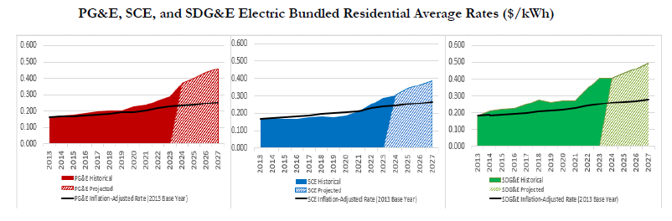
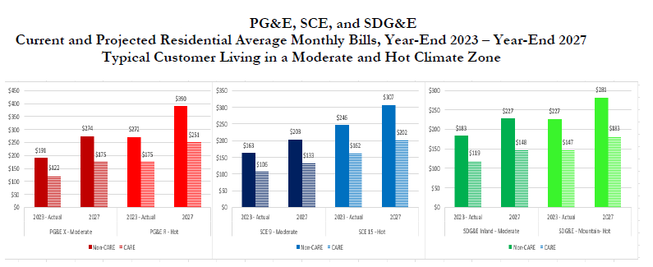
Forecasted Rate and Bill Trends - Electric Bundled IOU Residential Customers
Between year-end 2023 and year-end 2027, electric bundled customer residential average rates are expected to rise about:
  PG&E – 10.8% annually
  SCE – 6.8% annually
  SDG&E – 5.6% annually
This is in comparison to an assumed inflation rate of 2.6%.
Between year-end 2023 and year-end 2027, electric bundled customer residential average monthly bills are expected to rise for moderate (mod) and hot climate zones about:
  PG&E Non-CARE – $85 mod / $120 hot
  PG&E CARE – $55 mod / $75 hot
  SCE Non-CARE– $40 mod / $60 hot
  SCE CARE – $25 mod / $40 hot
  SDG&E Non-CARE – $45 mod / $55 hot
  SDG&E CARE – $30 mod / $35 hot
T
Notes:
A rates forecast published by Cal Advocates July 22, 2024 shows similar expectations for rates out to year-end 2025 (2026 and 2027 were not forecast).
Actual annual rate increases to 2024 going back two full GRC cycles for each utility:
PG&E: 12.7%
SCE: 11.0%
SDG&E: 11.4% (to 2023)

Slide 45
Brief History of the Disconnections Rulemaking and
California Senate Bill 598
Senate Bill 598: Passed in 2017 and requires the CPUC to develop an annual report on residential and household gas and electric disconnections
R.18-07-005: Disconnections Rulemaking launches in July 2018.
Goal to consider new approaches to reducing disconnections, speeding up reconnections, and improving energy access for residential customers
Disconnections rate caps established – as of 2024, the disconnection rate targets are:
  Pacific Gas & Electric Company (PG&E): 3.5%
  Southern California Edison (SCE): 4%
  San Diego Gas & Electric Company (SDG&E): 3%
  Southern California Gas Company (SoCalGas): 2%
Covid-19: Moratorium on Residential and Small Business Customer Disconnections and Arrearage Relief
Residential disconnections have increased since May 2023
Other rulemaking accomplishments – Arrearage Management Plan, Percentage of Income Payment Plan pilot, Community-Based Organization Arrearage Management pilot
Current issues with arrearages

Slide 46

California Arrearage Data Collection and Insights

Slide 47
Arrearages and Uncollectibles Have Accumulated Significantly Since the COVID-19 Outbreak in March 2020
Total Residential Arrearages ($Million)
Total Residential Uncollectibles ($Million)
 | PG&E | SCE | SoCalGas | SDG&E | Total
January 2019 | $230 | $81 | $57 | $61 | $429
March 2020 | $284 | $95 | $93 | $76 | $548
December 2023 | $651 | $862 | $353 | $261 | $2,127
December 2024 | $710 | $848 | $229 | $188 | $2,017
 | PG&E | SCE | SoCalGas | SDG&E
Average Uncollectibles 2018-2022 | $51 | $18 | $9.3 | $10
2023 | $179 | $40 | $38 | $27
2024 (Projected) | $123 | $72 | $44 | N/A

Slide 48
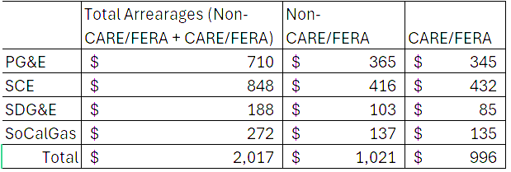
2024 Year End Arrearages: $2 billion
Arrearages as of December 2024 ($million), approximately 50% from non-CARE/FERA customers and another 50% from CARE/FERA customers
California Alternate Rates for Energy (CARE): 35% discount on electricity bills and a 20% discount on natural gas bills for qualifying low-income households
Family Electric Rate Assistance (FERA): 12% discount on electricity bills

Slide 49
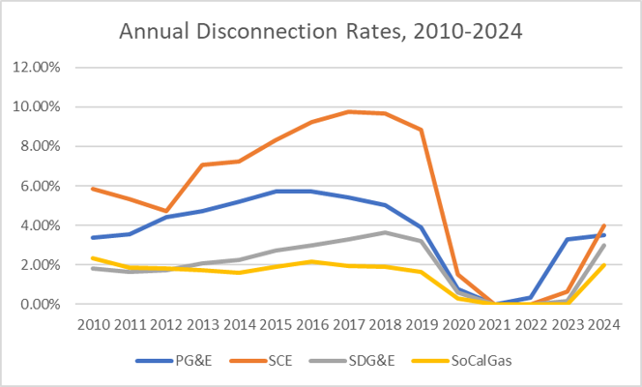
Annual Disconnection Rates by IOU

Slide 50
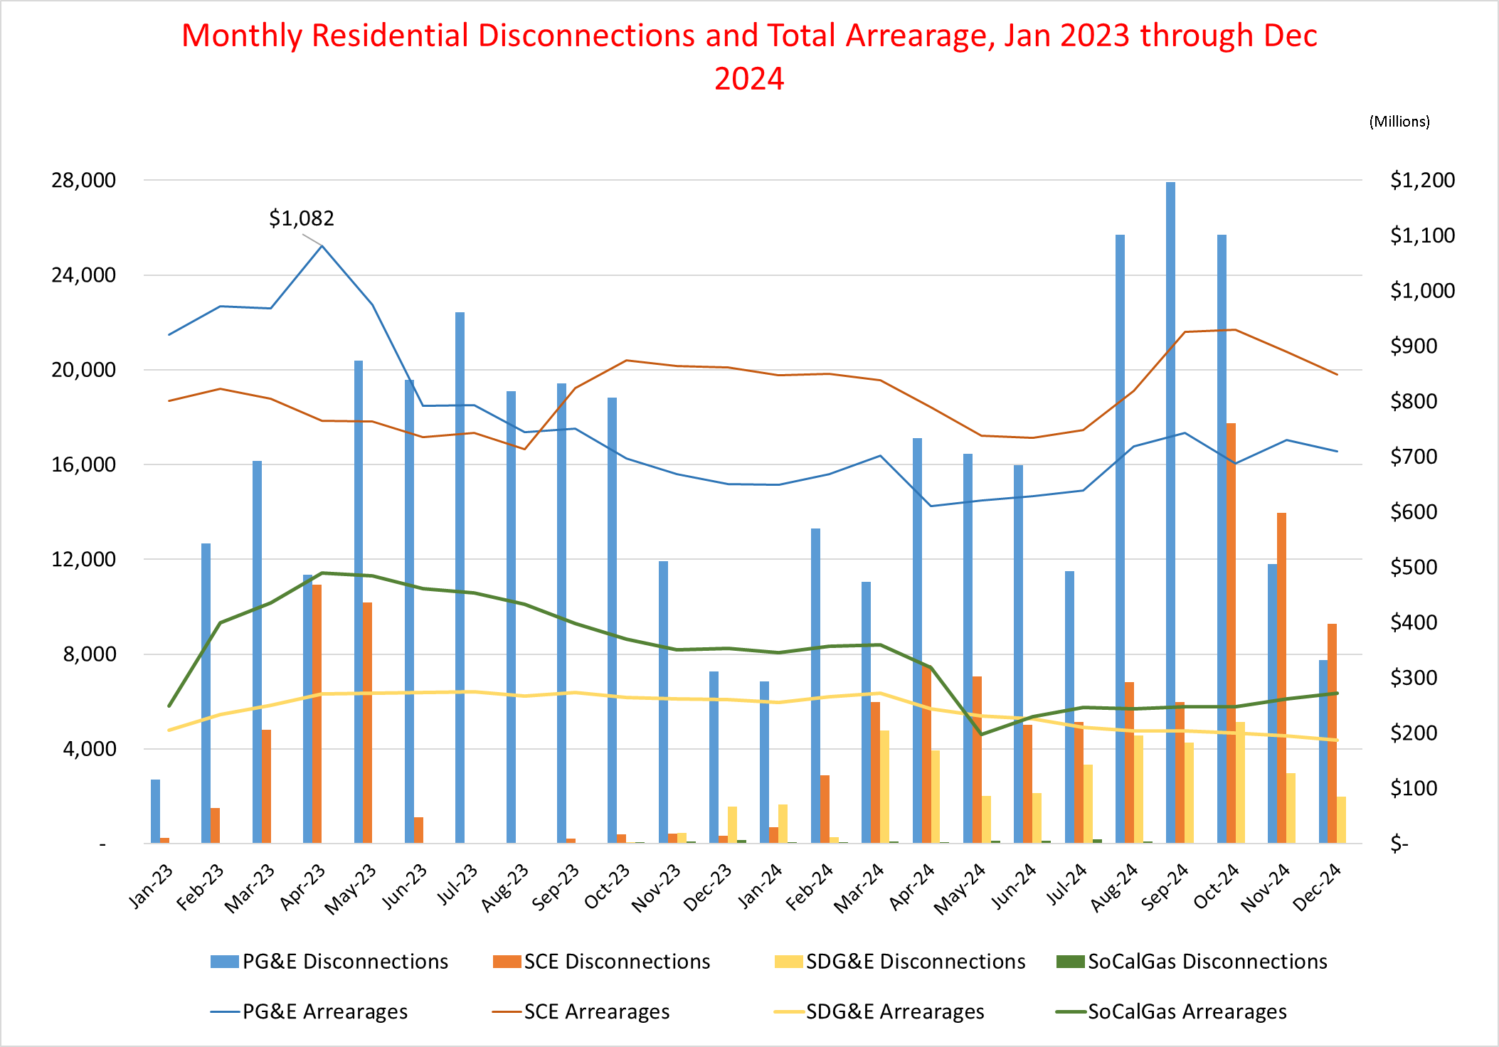
Monthly Residential Disconnections and Arrearages by IOU
Due to the California Climate Credit applied to bills in May 2024, SoCalGas's arrearages significantly reduced from approximately $300k to $197k. This reduction is not related to disconnections, as SoCalGas has disconnected fewer than 100 customers per month.
Notes:
Underlying spreadsheet: https://capuc-my.sharepoint.com/:x:/g/personal/jenneille_hsu_cpuc_ca_gov/Eb78lzVr9TJIjRlgtjUvkXoBNTqKCkNphMGR9MKQxi1I2A?e=x43ZnS

Slide 51
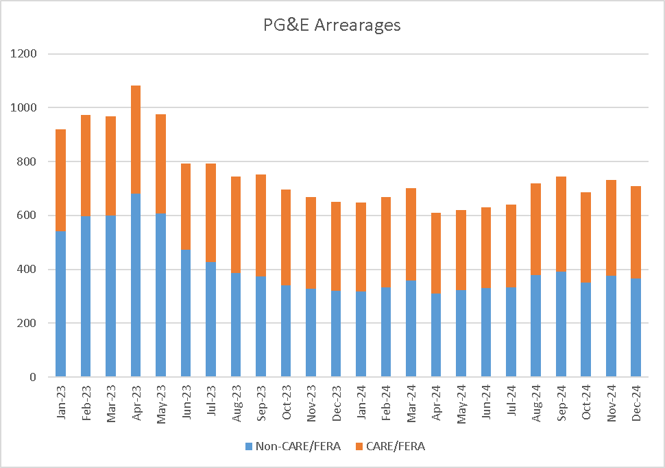
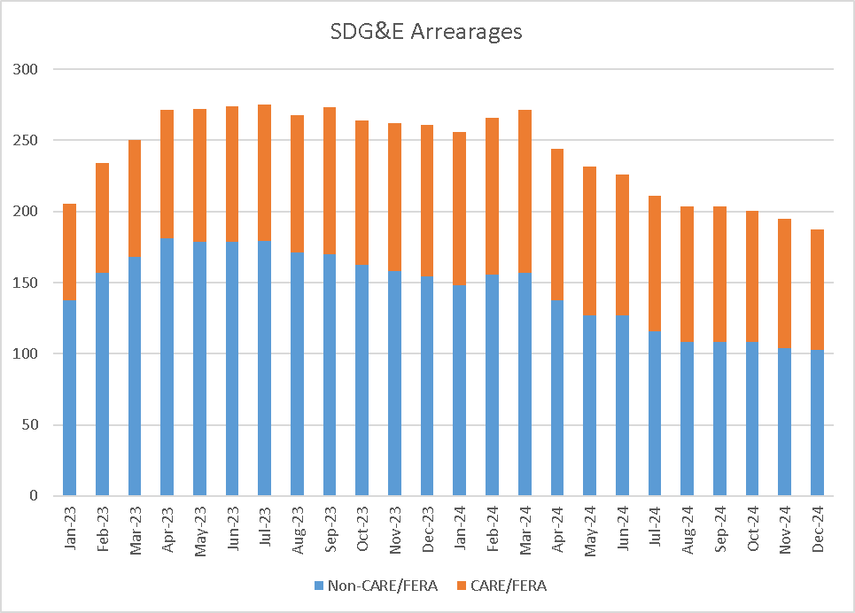
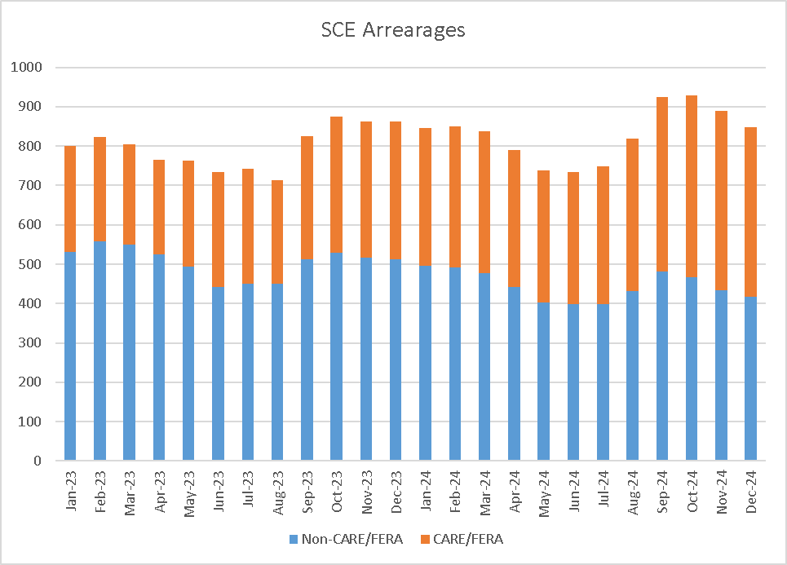
Utilities Disconnect More Non-CARE/FERA than CARE/FERA Customers:
Larger Reduction in Non-CARE/FERA Arrearages (Blue Bars)

Slide 52
California’s Arrearage Related Customer Programs

Slide 53
Arrearage Management Plans (AMP): Program Details
AMP is a debt forgiveness payment plan option for customers with past due bills greater than $500 and 90 days of age or older.
AMP will forgive 1/12 of your utility debt after each on-time payment of the existing month’s bill. After twelve on-time payments of individual monthly bills, your debt will be fully forgiven.
  The maximum amount eligible for AMP forgiveness in a calendar year is $8,000.
A customer can miss up to two non-sequential payments. The missed payment must be made up on the next billing due date with an on-time payment of both the current bill and the past bill(s).
  Missing two sequential payments will break the AMP.
  Customers who complete or break or do not finish AMP are eligible to sign up again after a 12-month waiting period.
The rules and guidelines for AMP and COVID Payment Plans require customers to make on-time payments of their current billing charges, as well as any payment installments.
Based on customer sentiment/feedback, a large portion of customers enroll in AMP and Payment Plans as a means of prolonging protection from disconnection.
  The target customer for AMP and Payment Plans are those that are able to pay their current billing charges.

Slide 54
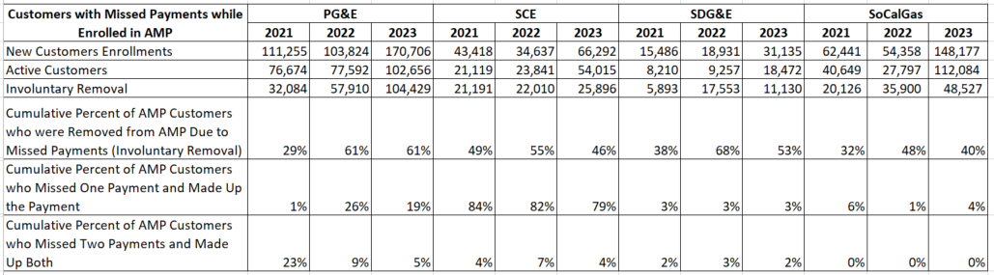
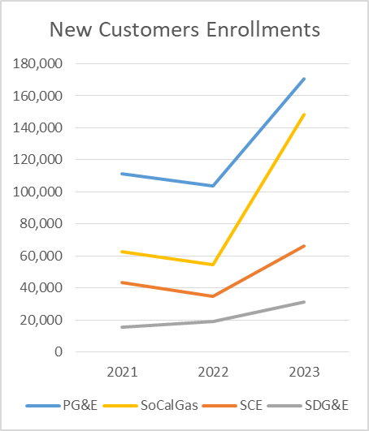
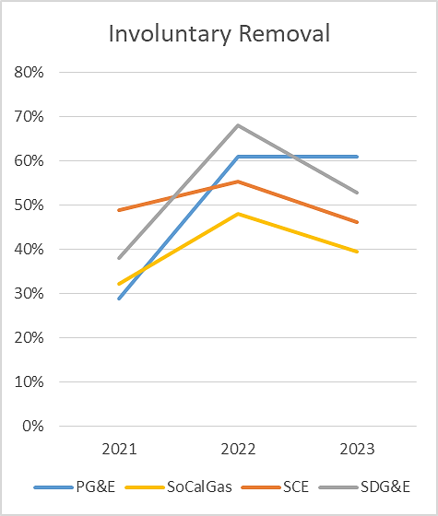
Recent AMP Data Updates
AMP enrollments increased in 2023
The Involuntary Removal rate improved in 2023 for SCE, SDG&E, and SoCalGas
PG&E had higher removal rate in 2023, compared to prior years

Slide 55
Percentage of Income Payment Plan (PIPP) Pilot
Provide CARE customers with lower fixed monthly bills.
The goals of the Pilot were as follows:
  Reduce the number of low-income households at risk of disconnection.
  Encourage participation in energy savings and energy management programs.
  Increase access to essential levels of energy service.
  Control program costs.
Two bill caps apply to all participants:
  Based on household of 3 at 50% and 150% of Federal Poverty Guidelines (FPG).
  Target energy burden of 4% (3% electric; 1% gas).
The PIPP Pilot is currently under review by independent Evaluator (report will be published soon), and is considered mostly quite successful, though scalability and cost are questionable.

Slide 56
The Community-Based Organization (CBO)
Arrearage Case Management Pilot
On February 15, 2024, the Commission voted to adopt the CBO Arrears Case Management Pilot to reduce residential energy service disconnection (D.24-02-046).
  IOUs to contract with CBOs to provide case management services to assist 12,000 customers in managing their unpaid bills, enrolling in energy assistance and energy efficiency programs, and arranging bill payment plans.
  Targets communities where bills are the highest relative to available resources.
  Pilot Size:12,000 Participants (4,800 PG&E customers, 4,800 SCE & SoCalGas customers, 2,400 SDG&E customers)
Participating customer eligibility criteria:
  Reside in a target zip code (Affordability Ratio, 20th percentile – “AR20”)
  Have arrears at least 90 days old and may be at risk for disconnection.
  No income qualifications –any income level will qualify.
Will be evaluated later, and has promise for being a more scalable solution for our most vulnerable customers once we’ve brought arrearages closer to historic baselines by IOU.

Slide 57
Presentation #4:
Jessica Freedman & Julian Aris
Assistant Attorney General, Division of Energy & Ratepayer Advocacy, Massachusetts Attorney General’s Office
At the AGO, Jessica has focused primarily on rate design, electric vehicle programs, solar proceedings, the Commonwealth’s “future of gas” proceeding, and on issues relating to energy affordability and public participation. Before moving back to Massachusetts in 2019, Jessica worked at the Hawaii Public Utilities Commission, as well as at the Office of Hawaiian Affairs and the Intermediate Court of Appeals.
Julian’s work at the AGO focuses primarily on energy affordability, low-income programs (e.g., low-income discount rates, arrearage management programs), and enhancing public access and participation. Before joining the AGO in 2023, Julian previously worked at the Sierra Club in the Beyond Coal Campaign.

Slide 58
Utility Disconnection in Massachusetts
Jessica Freedman & Julian Aris
Assistant Attorneys General
Energy & Ratepayer Advocacy Division
Notes:
Intros; by statute, our division is the ratepayer advocate, asked to talk about disconnection protections in place in Massachusetts and our office’s advocacy efforts. I’ll start things off and then pass to Julian.

Slide 59
Disconnection Protections
Disconnection is prohibited in certain circumstances, when there is financial hardship:
  serious illness, requires certification
  all household residents are 65 or older and a minor resides in the home
  a resident under 12 months
  winter moratorium from November 15 – March 15; typically extended to April 1, based on proposals from advocates with DPU approval
  M.G.L. ch. 164, § 124A, E, G, H; 220 CMR 25.03
Notes:
Mass has several disconnection protections in place. They all rely on a showing of financial hardship, which is met when a customer cannot pay their overdue bill, and meet eligibility requirements for LIHEAP (60% of SMI). I did want to flag that a customer can make an initial request for disconnection protection by phone, with certification required (e.g., financial hardship form).
Like Hawaii, Mass had a moratorium on all disconnections during the COVID pandemic. There were, not surprisingly, significant increases to total arrears during the pandemic. Since the pandemic, we’ve actually seen the total amount of arrears for residential customers increase between Feb. 2021, during the height of the pandemic, and February 2023 ($826 million, which is $44 million more than Feb 2021). For low income customers specifically, arrears were at a record high in Feb 2023 (up 38% from the start of the COVID pandemic in March 2020).
Detailed notes in case there are questions: Gas and electric companies cannot shut off, and must restore service, to households during the time when a household has a “serious illness” and when there is a “financial hardship”; requires that a registered physician or the local board of health to certify in writing.
Financial Hardship, shall exist when a customer is unable to pay an overdue bill and such customer meets income eligibility requirements for the Low-income Home Energy Assistance program administered by the Massachusetts Department of Housing and Community Development, or its successor, or when the Director of the Department's Consumer Division, or his designee, determines that such a finding is warranted. 220 CMR 25.01(2)

Slide 60
Support to Avoid/Delay Disconnection
For Income-Qualified (low-income) Customers:
Low Income Discount Rates (required by legislation)
Arrearage Management Programs (required by legislation)
Other programs:
Extended/Deferred Payment Plans
Good Neighbor Fund
Budget Billing
Notes:
The energy affordability programs in place in Massachusetts are part of a toolkit that can assist low income customers pay their bills, and thus avoid disconnection. The LIDRs, required since the 1990s, reduce a customer’s total bill by between 25 and 40%. A tiered rate was recently approved for one of the large electric utilities, which includes 5 tiers, based on income. Customers in the lowest income tier will receive 71% off their total bill, and customers in the highest income tier will receive a 32% discount.
Arrearage Management Programs are offered by all utilities, as required by legislation from 2005. For each month that a customer makes their AMP payment, a portion of their past due amount is forgiven. Different companies have different total forgiveness limits and different amounts of time for each plan (minimum in practice is one year, but the legislation states the minimum should be 4 months unless good cause is shown). An annual review is required; we’re advocating for more customer-friendly policies, designed to make it easier for customers to complete their AMP.
Extended payment plans provide customers with more time to pay their past due bills, and also protect a customer from disconnection, similar to an AMP, provided the customer makes the payments according to their plan.
The Good Neighbor Fund is available for customers with annual household income at 60-80% SMI, who do not qualify for any federally funded assistance programs and who are in need of temporary financial assistance; provides up to $400 per heating season (admin by Salvation Army)
Budget billing sets monthly bills at the same amount all year, based on historic usage. Bills are reset every fall, so if a customer over or under paid, it’s reconciled, and then the new monthly bill amount is reset.

Slide 61
Income Eligibility
Eligibility set by statute & HEAP
  200% of Federal Poverty Level, or HEAP eligibility (if it is higher than 200% of FPL)
    HEAP eligibility is set at 60% of state median income ("SMI"). G.L. . c. 164, § 1F(4)(I)
Eligible for: discounted electric and gas distribution rates, arrearage management plans, certain weatherization and energy efficiency programs/assistance
Notes:
For background, in Mass, “Low income” in the utility context is 60% of SMI. The statute sets a safety net threshold at 200% FPL; upper bound is HEAP eligibility, which is set by the state at 60% SMI. For example, 200% of FPL is $64,300 for a household of 4 for 2025, and 60% of SMI is $94,600 for a household of 4.
HEAP eligibility is set by the Massachusetts Department of Housing and Community Development, or its successor (Executive Office of Housing and Livable Communities)

Slide 62
Notes:
For additional background, participation rates in each distribution companies’ LIDR is between 10 and 27%, with marginally higher enrollment in the smaller companies, so that’s Unitil, Berkshire, and Liberty. We think that around 30% of eligible households are participating statewide. While this is enrollment in discount rates, I wanted to give an idea of the number of people on the discount rate, and thus potentially eligible for disconnection protections that are based on financial hardship, here are the customer counts and percentages of customers on the LIDR for each electric and gas company.

Slide 63
Example, Costs to Electric Ratepayers
2023 Typical Residential Monthly Bill
 |  | Percent of Total Bill
Basic Service Cost | $ 137.57 | 57%
Distribution Charges | $ 81.73 | 34%
Transmission Charges | $ 25.49 | 10%
Transition Charges | $ (1.45) | -1%
Total | $ 243.34
RAAF | $ 8.26 | 3%
Energy Efficiency | $ 15.65 | 6.4%
Electric Vehicle Program | $ 0.14 | 0.1%
Notes:
Important thing to observe here is that, while these low-income programs are super impactful for struggling households, they actually come at a very low overall cost. The RAAF reconciling mechanism through which low income program expenses are recovered represents only about 3% of the typical residential ratepayer's monthly bill. This puts it basically right in between the cost of the EE programs at 6.4% and the Electric Vehicle Program at 0.1%.
Values in the chart are based on ERA's 2023 Typical Monthly Electric bill (weighted average rates of the EDCs) and 650 kWh/mo.

Slide 64
Revenue Shortfalls
the shortfalls from low-income discount rates and arrearage management plans are allocated to all rate classes (including C&I)
  Direct and indirect benefits across service territories
  a statewide recovery factor would reduce costs for some customers; increase for others
Notes:
With regards to the shortfall from the LIDR and the AMP, our office has identified some benefits to having all rate classes contribute to these programs, even though the shortfall related to the programs are going to fund programs for the residential class. we have argued that if customers’ energy bills are affordable, there are likely to be economic and societal benefits across the state, as ratepayers with lower bills may spend that money in their community, supporting economic development and job creation. Re: societal benefits, there are a range of negative impacts associated with unaffordable bills, for example increased mobility (leaving homes), reduced food expenditures in cold months, not seeking medical care, and having to make hard choices, to pay for rent or a mortgage, food, medicine, or energy costs. There is also data showing that people struggling with high bills may engage in energy limiting behavior, such as heating homes with gas stoves or keeping indoor air temperatures at unsafe levels. We have also asked the DPU to consider funding these programs on a statewide basis, which in effect would lower rates for small companies and increase rates for large companies. We have also advocated for non-ratepayer funds for affordability programs as well as decarbonization initiatives.

Slide 65
AMPs
Arrearage Management Programs
Idea: customer given flat, affordable monthly payments for specified duration.
  Customer’s arrearage is partially forgiven each month they make their payment, and customer cannot be disconnected as long as they are on an AMP & making their payments.
  System benefits:
    Helps struggling customers develop better payment habits
    Incentivizes customers in arrears to pay at least some of what they owe (vs. paying none, which is often what happens for customers with substantial arrearages).
      Can reduce bad debt!
Notes:
The term we gave to debt relief programs to make sure no one has any clue what we’re talking about.
Important note – while this presentation has a narrow focus on system benefits and customer utility-related benefits, there is a vast array of data demonstrating a substantial number of customer benefits associated with avoiding disconnection that include improved financial circumstances, better health outcomes, better education outcomes, greater job stability, etc. Disconnections come at a substantial human cost – things like loss of food, loss of medications requiring refrigeration, negative health and illness consequences (including increases in hospital emergency room visits), and lost wage hours (lost wage hours are particularly high when a disconnection forces a customer to find a new residence, because the moving process costs them additional missed work time, and may even require them to find a new job). So there are substantial broader societal benefits that accrue from reducing disconnections.
Also worth noting that it’s unclear whether disconnections (or the threat thereof) actually result in more revenue collection. Analyses done in some states suggest that this may not be the case. So we have requested that the utilities provide us data regarding the connection between disconnections (or threat thereof) and revenue collection for their operations here in MA. Notably, even this data looks at the issue quite narrowly, as it ignores what a customer might do to afford the payment needed to avoid a disconnection. We already know from research that customers make harmful choices and dangerous sacrifices to manage to make these kinds of payments. They take out loans they cannot possibly afford to pay back, stop paying for essential (potentially life-saving) medications, food, etc. These behaviors may avert one harm but cause another (potentially worse) harm, and also tend to increase the existing financial hardship, making it even less likely that the customer will be able to make their utility payments in the future.
Arrearage forgiveness per month is based on total arrears and length of customer AMP – calculated such that if customer makes all their payments for the duration of their AMP their entire arrearage is forgiven. So if a customer is $1200 in arrears and is placed on a one-year AMP, each month $100 is forgiven, so at the end the customer is out of arrears.
Important to acknowledge reasons customers substantially in arrears may stop paying. The most poignant issue, in my opinion, is that these customers (who are already clearly experiencing substantial financial hardship) basically do not benefit at all from payments unless they can pay down the entirety of their arrears – if they remain at risk of disconnection even if they’re paying (because they’re still in arrears the whole time), then payment does nothing to avoid the worst possible outcome. AMPs change that – now, as long as the customer is making their payments, they are protected from disconnection.
To the extent these customers pay into the system when they otherwise would not have (or would have paid less), the AMPs reduce the amount of bad debt that will eventually be recovered from ratepayers.

Slide 66
Massachusetts Status Quo
All distribution companies required to offer AMPs to income-qualifying customers (<60% SMI).
Statute requires minimum AMP length of 4 months.
Most companies have some form of auto-enrollment.
All companies have a cap on annual forgiveness amounts, but the caps vary broadly by company ($3,000 - $12,000).
  Adding to the variance, some companies allow for AMPs >1yr, but others cap at 1yr.
Customer monthly payment determined by dividing projected annual bill by 12.
Notes:
Note that, because the income threshold is the same, a customer applying to enroll in an AMP will also be enrolled in the LIDR if they are not already.
Statute: St. 2005, c. 140, § 17 (https://malegislature.gov/Laws/SessionLaws/Acts/2005/Chapter140)

Slide 67
Notes:
There are a lot of concerns about affordability in Massachusetts right now with spikes in natural gas prices and recent increases to bills (linked to energy efficiency programs). Here is AMP cost comparison across utilities – can see that overall AMPs are a relatively small part of revenue, but there’s notable variance. No specific cap on AMP or LIDR costs, but LIDR costs especially are reviewed in rate cases (just and reasonable rates standard).

Slide 68
AGO AMP Advocacy Efforts
Best Practices Working Group
AGO Requested Changes:
  >1yr AMPs available to all customers
  Max stay-out period of 3 months
  Minimum 60-day grace period for missed payments
  Improved customer communication policies
  Give Community Action Partnership agencies > 2 weeks to review and provide feedback re customer communication materials
  Give Working Group opportunity to review and provide feedback on company AMP policies each year before filing
  Limit periods of auto-enrollment to June-Sept. to avoid unnecessary enrollments
  Improved data tracking and reporting
Notes:
Note that in MA there’s a working group that includes the regulated distribution companies and various stakeholders (AGO, National Consumer Law Center, Low-income Energy Affordability Network, Community Action Partnership (“CAP”) agencies, etc.) that was created to make space for parties to educate each other and work on improvements. Helps promote collaboration and compromise between parties, and avoid formal and adversarial proceedings before the DPU. For the moment, this is where our advocacy is concentrated. Formal proceedings are a last resort.
Stay-out period = amount of time a customer must “stay out” of an AMP in between completing or defaulting out of one AMP and beginning another AMP.
Grace period – time following a missed payment before customer defaults out of their AMP. During grace period customer can cure their deficiency and their AMP plan remains unchanged.
In MA the Companies have to file an AMP plan with the DPU every year. These are basically approved upon filing, so they do not necessarily beget proceedings of any kind – unless a party decides to request formal proceedings to address disputed issues (that could not be resolved through conversations with the working group).
Unnecessary enrollments – customers who will be receiving assistance through the Home Energy Assistance Program (“HEAP”) that will be sufficient to cover their arrears. These customers will resolve their arrears as soon as assistance is distributed, and will not benefit from placement onto an AMP.

Slide 69
Some Advocacy Details
Communications: avoid “low-income” and “arrears”
Affordable payments: dividing a customer’s projected annual bill by 12 does not result in affordable payments.
  Affordability, definitionally, is inextricably linked to ability to pay.
  Ability to pay is conspicuously absent from the existing formula for calculating monthly payments.
    Indeed, the fact of the arrearage suggests that the customer’s annual bill is unaffordable, so setting the “affordable” payment amount by evenly dividing the annual bill seems almost comically obtuse, and may not align with the statutory mandate to provide AMP participants with “affordable” monthly payments. (TBD)
Notes:
The term low-income itself is a barrier to participation. Many customers do not consider themselves low-income and so think the program is not for them and they would not qualify. For others, a sense of pride causes them to balk at participating in programs marketed as being for “low-income” people/families. Instead, use terms like “income-qualified” or “income eligible.”
For the love of god stop saying “arrears” or “arrearage” – nobody knows what those mean but us niche policy wonks. Even Adobe (Adobe!!) does not know that word – it gets flagged as misspelled if you use it in a comment box in a pdf. It’s not scientific, but I reached out to several highly educated folks in my social network and only a single person was able to tentatively answer correctly when I asked if they new what “arrears” or “arrearage” meant. Just say “debt forgiveness” or “debt management” like a normal human being.

Slide 70
*Checks Watch* … Hmmmmm 👀
There’s a lot more than we could fit into 15 minutes, but here are some resources for further exploration:
  Us! (We’re pretty sure we know some things?)
    Julian.Aris@mass.gov, Jessica.Freedman@mass.gov
  “Energy Affordability Docket” (D.P.U. 24-15)
    Go to the DPU Fileroom (full link in slide notes) → type “24-15” into search
    Broad inquiry into energy burden and energy affordability for residential ratepayers. Already multiple rounds of comments, and lots of informative content provided by the Attorney General and other stakeholders
    “Ratepayer Interview Insights Brief” https://fileservice.eea.comacloud.net/FileService.Api/file/FileRoom/19853733
Notes:
Probably self-evident due to likely failure to end within 15 minutes …
https://eeaonline.eea.state.ma.us/DPU/Fileroom/dockets/bynumber
The Energy Affordability Docket (DPU 24-15) was initiated by the DPU to broadly explore energy burden and energy affordability for residential ratepayers. The Fileroom format is rather … noisy, shall we say? I recommend liberal use of “ctrl + F” to find your way to “comments” or, perhaps, filings by certain parties.

Slide 71
Break (10 min)

Slide 72
Presentation #5:
Roger Colton
Partner, Fisher, Sheehan & Colton Public Finance and General Economics (FSC) of Belmont, Massachusetts
Roger Colton is an attorney, economist, and partner at Fisher, Sheehan & Colton, based in Belmont, Massachusetts Specializing in low-income utility affordability and consumer protection policies, he has worked with state and local governments, utilities, and community organizations to design, implement, and fund affordability programs that improve energy access for vulnerable households.

Slide 73


Responding to / Preventing Utility Disconnections for Nonpayment (DNPs)
Roger Colton
Presentation to Hawaii PUC
Docket No. 2022-0250
March 5, 2025
Notes:
Roger Colton is an attorney and economist. He is the owner of the firm Fisher, Sheehan & Colton, Public Finance and General Economics, of Belmont (MA). He can be reached at roger@fsconline.com.

Slide 74
The Best Way to Prevent Nonpayment Disconnections is to Make Bills Affordable

Slide 75
Average arrears / termination rates(2023) (residential vs. Confirmed Low-Income) (PA)
Electric Utilities |  |  |  |  | Natural Gas Utilities
 | Average Arrears |  | Termination Rate |  |  | Average Arrears |  | Termination Rate
 | Res | CLI | Res | CLI |  | Res | CLI | Res | CLI
Duquesne | $390 | $664 | 4.5% | 17.3% | Columbia | $792 | $945 | 2.5% | 8.3%
Met-Ed | $594 | $757 | 5.1% | 22.7% | NFG | $397 | $565 | 3.6% | 13.7%
PECO (e) | $513 | $1,366 | 5.7% | 18.2% | PECO (g) | $798 | $2,036 | 4.1% | 20.9%
Penelec | $640 | $779 | 3.9% | 14.9% | Peoples | $485 | $681 | 3.6% | 10.5%
Penn Power | $713 | $883 | 2.7% | 13.8% | PGW | $810 | $893 | 7.2% | 15.8%
PPL | $798 | $1,086 | 1.4% | 5.0% | UGI (g) | $538 | $884 | 5.0% | 6.2%
West Penn | $622 | $802 | 3.2% | 15.9% | XXX
Notes:
The Pennsylvania PUC’s Bureau of Consumer Services annually publishes its report titled Universal Service Programs and Collections Performance. The 2023 Report (September 2024) included data consistent with prior years. The BCS report shows that the average arrears of “Confirmed Low-Income” customers, as well as the “termination rate” of Confirmed Low-Income customers, is much higher than for residential customers as a whole. In Pennsylvania, “Confirmed Low-Income” is a term of art, defined by PUC regulation, to include any customer for whom the utility has reasonable information demonstrating low-income status. Such information can be provided in payment plan negotiations, in requests to be exempt from winter shutoffs, or through other processes. It can be self-attested.

Slide 76
Pennsylvania’s Percentage of Income Payment Plans Bill Payment Coverage Ratios
 | Test Year Enrollees |  |  | Net Change Relative to Comparison Group
 | Pre-CAP | In CAP | Change
PGW (2019) | 72% | 92% | 20% | 36%
PPL (non-htg) (2020) | 84% | 98% | 15% | 21%
PPL (heating) (2020) | 83% | 104% | 21% | 26%
Peoples Gas (2017) | 85% | 123% | 39% | 36%
First Energy (Met Ed) (non-htg/htg) (2017) | NA | 91%/93% | NA | NA
First Energy (PN) (Non-htg/htg) (2017) | NA | 91%/119% | NA | NA
First Energy (PP) (non-htg/htg) (2017) | NA | 100%/98% | NA | NA
UGI (electric) (2012) | 60% | 66% | 5% | 18%
Duquesne Light (non-htg) (2015) | 77% | 94% | 17% | 31%
Duquesne Light (htg) (2015) | 75% | 92% | 17% | 23%
Notes:
Pursuant to a Commission decision in the late 1980s, only subsequently built into state statute, each utility developed a “customer assistance program. (CAP). By PUC regulation, these CAPs must be periodically evaluated by an independent third party. The “payment coverage ratio” calculates the percentage of bill actually paid (amount of payment in numerator; amount of bill in denominator). The “net change” is the change for the CAP population minus the change for the comparison population. For example, if CAP improved by 15% and the comparison population improved by 3%, the “net change” is 12%. If CAP improved by 15% and the comparison declined by 5%, the “net change” is 20%.
The evaluations found across-the-board that offering affordable payments increased the payment coverage ratios. And not by “a little” but by “a lot.” These findings are consistent with the basis the Pennsylvania PUC used to adopt the programs in the first instance. The programs were adopted as an outcome of an investigation by the PA PUC into how to control uncollectables, NOT on how to address low-income energy needs.

Slide 77
New Jersey’s Universal Serv ice Fund
Distribution of Effective Coverage Rate by Net Energy Burden (gas or electric: 3%)
 | Payment Coverage Rate
Burden | < 50% | 50% - <90% | 90% - <100% | 100% or more
<2% | 0.0% | 2.7% | 5.3% | 92.0%
2% - 3% | 0.0% | 6.0% | 11.5% | 82.5%
3% - 4% | 0.0% | 10.0% | 13.2% | 76.9%
4% - 6% | 0.0% | 11.6% | 16.6% | 71.6%
6% - 8% | 0.4% | 16.6% | 17.4% | 65.6%
More than 8% | 1.0% | 25.6% | 16.1% | 57.4%
Notes:
The New Jersey Board of Public Utilities (BPU) also adopted an affordability programs, called the Universal Service Fund (USF). The evaluation of the USF found that as bill burdens became affordable as a percentage of income, the bills were more completely paid. The Table above, for example, shows that between 82.5% and 92% of customers with burdens of 2% or less paid 100% or more of their bills –a payment of more than 100% indicates the customer is paying their entire bill for current service plus retiring some arrears– while fewer than 60% of customers with burdens of 8% or more paid 100% of their bill.
Conversely, while 40% or more of customers with burdens of 6% or higher paid only 50% to 90% of their bills, much fewer (2.7% to 6.0%) of customers with burdens of 3% or less had payment coverage ratios that low.

Slide 78
Philadelphia Water Department’s
Tiered Assistance Program
Notes:
While not involving by a state-regulated utility, the Philadelphia City Council unanimously approved legislation directing the Philadelphia Water Department to implement what was called, in the legislation, the Income-based Water Rate Affordability Program (IWRAP). That program became operationally known as TAP (Tiered Assistance Program). The TAP caps bills for low-income customers (at or below 150% Poverty Level) at an affordable percentage of income.

Slide 79
Where TAP participants start. . .
Notes:
When one examines the impact of Philadelphia’s TAP, you need to start with what was happening before TAP came into being. That can be examined by looking at the percentage of low-income customers who enter TAP with a pre-existing arrears and what those arrearage balances (in dollars) were (on average).
The top Chart above shows that from the very beginning, low-income customers were not able to pay their bills before enrolling in TAP. Consistently close to 100% of TAP participants are entering the program with pre-existing arrears. That observation will be important time and time again, and will be referenced multiple times below.
The bottom Chart shows that the arrearage balances being carried without the affordability program were substantial, frequently reaching $2,500 or more.

Slide 80
A comparative TAP payment performance
Notes:
This comparison shows the difference in low-income payment patterns before and after TAP participation as well. The top Chart shows the number of new TAP enrollees (the bars) against the number of new TAP enrollees with arrears (the line). As observed earlier, nearly all low-income customers enrolling in TAP bring unpaid bills with them. In contrast, the bottom chart shows the number of TAP bills issued each month (the bars) against the number of TAP bills that were issued that carried a long-term (120+ days) unpaid balance at the time the bill was issued.
TAP has not eliminated unpaid bills by low-income customers. However, the improvement has been enormous.
One can see that the number (and percent) of TAP participants with an arrearage of 120 or more days appearing on their bill has levelled off at around 25% of the TAP population. While the availability of COVID-related emergency federal water assistance in 2021 helped bring those arrearages down even further, the proportion of low-income accounts with long-term TAP arrears over time relative to the proportion of low-income accounts entering TAP with pre-existing arrears is dramatically lower than the percentage of low-income customers enrolling in TAP with huge pre-existing arrears.

Slide 81
Notes:
TAP payments substantially improve as measured by the “Payment Coverage Ratio” shown in this Chart. As in the Pennsylvania and New Jersey data above, the Payment Coverage Ratio is a simple ratio. It calculates the percentage of a bill that is being paid by placing the dollars of payments in the numerator and the dollars of bills in the denominator.
The Chart above shows that TAP has taken that low-income population, nearly 100% of which was behind on their bill payments upon entering the program, and converted those low-income customers into reasonably good-paying customers. The Chart above shows two important things: (1) TAP customers are consistently paying 80% (or more) of their bills; and (2) the Bill Payment Coverage ratio demonstrates a noticeable upward trend. The longer a TAP participant remains on TAP, the better their bill payment patterns become.

Slide 82
Completeness of Bill Payment (TAP and Non-TAP Low-Income [LI])
 | Percent Paid in 0 – 12 Months |  | Percent Paid in 0 – 24 Months
 | TAP | Non-TAP LI | TAP | Non-TAP LI
FY22 | 72.50% | 34.30% | N/A | N/A
FY21 | 72.47% | 46.12% | 83.83% | 62.64%
FY20 | 72.80% | 45.92% | 87.13% | 59.45%
FY19 | 72.03% | 48.71% | 87.89% | 61.80%
FY18 | 73.13% | 36.06% | 95.69% | 45.12%
FY17 | No TAP | 42.74% | No TAP | 54.80%
FY16 | No TAP | 45.96% | No TAP | 59.69%
FY15 | No TAP | 45.63% | No TAP | 59.77%
Notes:
Knowing that more than 90% of TAP participants enter the program with pre-existing arrears, the next question would be: “does TAP help low-income customers improve their bill payment patterns?” This Table shows the percentage of bills paid by the 12-month mark after a bill is received (for TAP participants and for low-income customers not on TAP). It shows the same data (i.e. the percentage of bills paid) by the 24-month mark after a bill is received as well. For years prior to FY2018 (the year TAP began), of course, there was no TAP, so the numbers show only how much of a low-income bill is paid without TAP.
At the 12-month mark, TAP customers have paid more than 70% of the bills they received. In contrast, at the 12-month mark, low-income customers not participating in TAP have paid only 36% (FY2018) to 46% (FY2021) of the bills they have received. At the 24-month mark, TAP customers are paying between 80% and 90% of the bills they have received. In contrast, low-income customers not participating in TAP have paid only 45% (FY2018) to 63% (FY2021) of the bills they received by Month 24.
TAP has substantially reduced the number of low-income disconnections. When more people pay more of their bill, the number of nonpayment disconnections decreases. In addition, when PWD issues a bill to a TAP participant, it knows that it will receive a higher percentage of payment in return than when it issues a bill to a low-income customer not on TAP.

Slide 83
TAP Collectability at Identified Points in Time by Fiscal Year
TAP FY 18: 1-Year | TAP FY19: 1-Year | TAP FY20: 1-Year | TAP FY21: 1-Year | TAP FY22” 1-Year | TAP FY-18: 2-Years | TAP FY19: 2-Years | TAP FY20: 2-Years | TAP FY21: 2 Years
73.13% | 72.0% | 72.8% | 72.5% | 72.5% | 95.7% | 87.9% | 87.1% | 83.8%
Cumulative Collectability for Low-Income Customers in Pre-TAP Years
 | 0 – 12 Mos | 13 – 24 Mos | 25 – 36 Mos | 37 – 48 Mos | 49 – 60 Mos | 61 – 72 Mos | 73 - 84 Mos | 85 - 96 Mos | >96 Mos
FY17 | 42.7% | 54.8% | 58.1% | 61.3% | 64.1% | 69.2%
FY16 | 46.0% | 59.7% | 64.5% | 66.8% | 69.3% | 71.2% | 75.0%
FY15 | 45.6% | 59.8% | 65.7% | 69.5% | 71.3% | 73.2% | 74.8% | 77.8%
FY14 | 46.6% | 61.4% | 67.6% | 72.2% | 75.1% | 76.4% | 77.7% | 79.0% | 81.5%
FY13 | 49.7% | 64.2% | 69.7% | 74.3% | 77.8% | 79.9% | 81.0% | 82.0% | 83.0%
FY12 | 46.3% | 60.2% | 65.2% | 69.3% | 72.9% | 75.6% | 77.3% | 78.1% | 79.0%
Notes:
In contrast to the previous page, these Tables present a comparison of how quickly TAP customers pay the PWD bills to how quickly low-income customers were paying their bills before TAP existed. First, look at the one-year mark. In the top Table, you can see that TAP participants consistently paid more than 72% of their bills by the end of 12-months. In contrast, in the years before TAP (bottom Table), you can see that in only two years (FY13, FY14), did PWD received a 72% bill payment (and even this occurs only by the end of 48 months, not the end of 12 months). In FY12, the 72% bill payment did not occur until the end of 60 months. In FY16, the 72% bill payment did not occur until the end of 84 months.
Remember, again, the TAP participant population is a population of low-income customers where every month, more than 90% of the customers enrolling in TAP were entering the program with pre-existing arrears. And those pre-existing arrears were in the thousands, not hundreds, of dollars. Under TAP, 72% of the bill is being paid within 12 months.
An even more dramatic difference can be seen if you look at the percentage of bill paid by the end of two years. Under TAP, low-income participants paid between 84% (FY21) and 96% (FY18) of the bills by the end of two years. Before TAP, low-income customers never achieved an 84% percentage payment of their bills, even after eight years (>96 months).

Slide 84
PSCo’s Pilot Energy Assistance Program (PEAP) (gas and electricity)
Notes:
Public Service Company of Colorado (PSCO), along with every other major Colorado utility, now operates a low-income discount program. The programs began with PSCO’s Pilot Energy Assistance Program (PEAP). The following data is taken from the evaluation of that PSCO low-income program.

Slide 85
Cumulative Customer Payment Coverage Ratio for Combination PEAP (G/E) Participants (21 – 24 Months) compared to LEAP and Residential Accounts
85
Notes:
PSCo’s low-income population brought an average of nearly $350 of pre-existing arrears to the low-income PEAP. The bulk of those arrears came from PEAP participants with large (e.g., greater than $1,000) pre-existing arrears. A full 60% of the pre-existing arrears were associated with PEAP accounts owing more than $1,000, with more than half of that brought by accounts owing more than $2,500.
This average is the average arrears spread over all customers, not the average spread over only the customers having arrears.
As with the charts above, this Chart measures the impact of the PEAP by reference to the Payment Coverage Ratio (i.e., the percentage of billed revenue that was actually paid). This comparison shows that low-income customers not receiving PEAP discounts have the lowest customer payment coverage ratios of the three comparison groups (PEAP, LEAP-non-PEAP, residential). In contrast, the PEAP population and general residential population have coverage ratio patterns that are virtually indistinguishable.
It is important to remember, of course, that this Chart does not indicate that PEAP customers and residential customers are making the same level of payments. Rather, the Chart indicates that the PEAP participants are paying virtually the same percentage of their discounted bills as residential customers in general are paying of their non-discounted bills.

Slide 86
Ratio of Number of Payments Resulting in $0 Balance: By length of PEAP Participation (in months)
86
Notes:
When one considers the impacts of a program on disconnections, it is possible to do so first by measuring the extent to which customers have a $0 balance. (A customer without an arrearage is in no danger of having service disconnected). This Chart uses a customer population that has participated in PEAP for fewer than six (6) months as the comparison population to that group of customers who participated in PEAP for between 21 and 24 months of the 24 month program. While between roughly 20% and 40% of the 1-to-6 month participant population made payments which reduced their bill balance to $0, between 60% and 70% of long-term (21 – 24 month) participants made payments which retired their entire arrears each month.

Slide 87
87
Incidence of Disconnections for Nonpayment by PEAP Participation, LEAP (by pre-existing arrears), Residential (by pre-existing arrears)
 | PEAP by months of participation |  | LEAP (by Month 1 arrears) |  |  | Residential (by Month 1 arrears)
 | 1 – 6 | 21-24 | $0 | $1 - $250 | $251+ | $0 | $1 - $250 | $251+
Average no. of DNPs per account /a/ | 0.03 | 0.003 | 0.02 | 0.02 | 0.03 | 0.02 | 0.02 | 0.02
Average no. of DNPs per account experiencing a DNP | 1.39 | 1.23 | 1.34 | 1.35 | 1.36 | 1.27 | 1.29 | 1.36
NOTES: /a/ Count of accounts as of Month 24. DNP = disconnection for non-payment.
Notes:
The impact of PEAP on disconnections for nonpayment (DNP) can be directly measured as well. This Table compares the numbers of disconnections per account, along with the numbers of disconnections per account experiencing a DNP. As can be seen, the PEAP initiative reduced the rate at which customers experienced nonpayment disconnections to a fraction of what other populations were experiencing.
The two comparison populations included recipients of Low-Income Energy Assistance Program (LEAP) (what is known federally as the Low-Income Home Energy Assistance Program, LIHEAP) and residential customers generally (which includes nonparticipant low-income customers). The LEAP and residential comparison populations were further disaggregated by the extent to which, if at all, the customers had an arrearage balance in Month 1 of the PEAP initiative.

Slide 88
New Hampshire’s (Eversource) New Start Program (Electricity Assistance Program) (EAP)
Notes:
Pursuant to state legislation, the New Hampshire Public Utilities Commission (NHPUC) approved an income-based rate discount program, the Electricity Assistance Program (EAP). Through the EAP, New Hampshire’s electric utilities offer tiered discounts. As household income decreased, the amount of discount provided increased. The program was based on five income tiers. Each tier was designed so that, at the income at the mid-point of the tier, the discount would reduce the electricity burden (at average consumption) to between 4% and 5% of income.
In addition, separate from the EAP, Eversource (the largest electric utility serving New Hampshire) implemented its New Start program. Through New Start, Eversource would “forgive” a pro rata portion of a pre-existing arrears in exchange for each complete payment a participant customer made toward their bill for current service.
In order to enroll in New Start, a customer must be a Hardship Customer (a term defined by PUC regulation) and have an arrears balance of at least $120 and 60-days old.

Slide 89
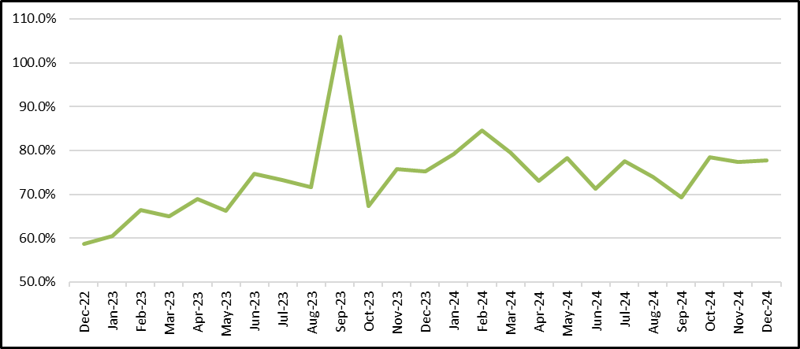
Payment Coverage Ratio: Eversource (NH)
Notes:
Reviewing what is now our old friend the Payment Coverage Ratio, Eversource converted those low-income customers in significant arrears (i.e., a balance of $120 which was at least 60 days old) into customers who are now paying roughly 80% of their bills each month. (There was a substantial uptick in the Payment Coverage Ratio for one month when there was an influx of assistance dollars provided in response to a spike in electricity supply costs.)
As was seen in the Philadelphia Water program above, the longer a customer remained on the program, the better their Payment Coverage Ratio became. There is a distinct upward trend in the Payment Coverage Ratio.

Slide 90
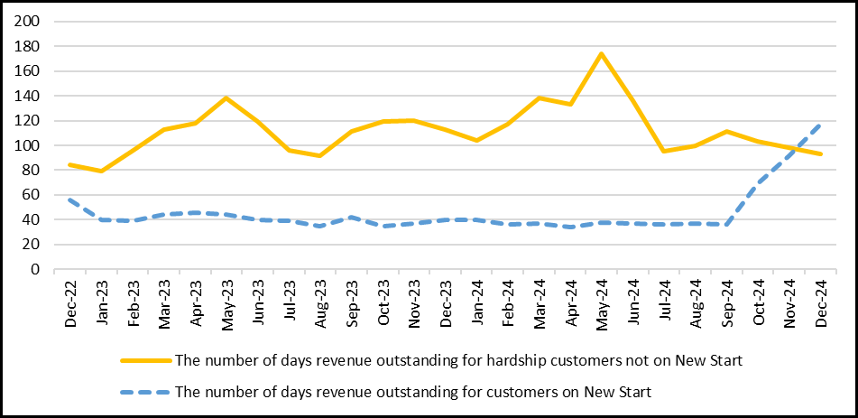
Eversource (NH): Days Revenue Outstanding: New Start Participants vs. Hardship Customers not on New Start
Notes:
Eversource also tracks, and reports, whether the combined impact of EAP and New Start helps to accelerate payments. Rather than examining the aging of arrears each month, the agreed-upon metric was for Eversource to report the “Days Revenue Outstanding” (DRO) on a monthly basis.
The DRO for hardship customers not on New Start is noticeably higher than the DRO for hardship customers participating in New Start. To the extent that DRO is reduced, the utility will experience a reduction in working capital, since a reduction in DRO will reduce the number of “lag” days contributing to a working capital requirement.
Moreover, in New Hampshire, working capital is a capital expenditure. As such, it generates a rate of return, one component of which is a return on equity. Since the equity return represents the company’s profit, it is subject to an income tax. The rate impact of improving DRO, therefore, is much higher than the simple reduction in working capital expenses.
One error exists in the Chart above. At a recent hearing (2025), the DRO for October – December for New Start participants was acknowledged by Eversource to represent a data reporting error. Corrected data has not yet been provided.

Slide 91
Wisconsin Electric Power Co. LIFT
(Low-Income Forgiveness Tool)
  “The LIFT program has resulted in the collection of over $13 million in customers payments of arrears balances that likely would not have been recovered and would have become bad debt.” According to the Wisconsin PSC Staff, “the applicants stated that they believe 100 percent of the LIFT ‘pre-program arrears’ would have been written off over time without the implementation of the LIFT program.”
Pub. Serv. Comm’n of Wis., Docket 5-TU-100, Staff Memorandum at 20 (November 20, 2023) available at https://apps.psc.wi.gov/ERF/ERFview/viewdoc.aspx?docid=485457.
Notes:
While time series data is not available for the WEPCO (Wisconsin Electric Power Company) arrearage forgiveness program, the information provided by WEPCO to the Wisconsin PSC Staff indicates that the Company’s LIFT program is benefitting the utility (in addition to program participants).
Through LIFT, as with each of the programs discussed above (Pennsylvania CAP, PWD TAP, Eversource New Start), the Company exchanges a “forgiveness” of a pro rata portion of pre-existing arrears (i.e., arrears on a customer account at the time the customer enters the program) for a complete payment toward a discounted bill for current service.
As the Company observes, it is better off as a result. Based on a study of four years of data for LIFT participants, WEPCO reported that “100% of the LIFT pre-program arrears would have been written off over time without the implementation of the LIFT program.”
WEPCO, in other words, is exchanging the “forgiveness” of dollars that would have been written off in any event, for complete payments toward future bills for current service.

Slide 92
Deferred Payment Arrangements are NOT the answer: they fail more often than they succeed
Notes:
When considering the ways to avoid/prevent disconnections for nonpayment, it is helpful to compare the results of programs such as those discussed above (PA CAP, PWD TAP, Eversource New Start) to more traditional responses to low-income non-payment. The most traditional response is to offer customers an opportunity to retire arrears through an installment payment plan (known by various terms in various places, deferred payment plans, deferred payment arrangements, installment payment plans, etc.). The term Deferred Payment Arrangement (DPA) is used here.
The problem with DPAs, when offered to customers who cannot afford their bills with which to begin, is that they do not “work.” Because the payment problem was caused by the inability to pay in the first instance, to respond by increasing the bill even further by adding an installment payment to the bill for current service, is not a path toward success.
The data below shows the impacts of DPAs from various utilities in Pennsylvania and Illinois.

Slide 93
Success of Deferred Payment Plans: Duquesne Light
Number of New Deferred Payment Arrangements, Defaulted Payment Arrangements (Confirmed Low-Income Customers) (Duquesne) (Feb. 2021 – March 2024)
 | Feb. – Dec. 2021 | Jan – Dec 2022 | Jan. – Dec. 2023 | Jan. – Mar. 2024
Number of New Payment Arrangements | 7,078 | 5,357 | 8,395 | 1,203
Number of Defaulted Payment Arrangements | 4,142 | 4,051 | 5,057 | 1,112
Notes:
Duquesne Light Company (DLC) is a Pennsylvania electric utility. The data above compares the number of new DPAs by time period to the number of defaulted DPAs. For February 2021 through December 2023, between 60% and 75% of DLC’s end up defaulting rather than allowing customers to successfully retire their arrears.
In the abbreviated period of the first three months of 2024, more than 90% of Duquesne’s new DPAs defaulted rather than being successfully completed.

Slide 94
Success of Deferred Payment Plans:
PECO (gas)
Number of Confirmed Low-Income Customers Newly Entering Payment Arrangement and Number of Payment-Troubled Customers (Confirmed Low-Income Customers) (PECO (Gas) (2022 – 2024)
Feb 2022 –Jan 2023 |  | Feb 2023 – Jan 2024
On Arrangement | Payment Troubled | On Arrangement | Payment Troubled
4,304 | 1,934 | 4,675 | 2,682
Notes:
This PECO (gas) data is similar to the other examples. In the twelve month February (2022) through January 2023, between roughly 45% and 60% of the new DPAs of PECO (gas) defaulted. As with other Pennsylvania data presented above, it is important to note that “Confirmed Low-Income” is a term-of-art defined by PUC regulation.
In addition, “payment-troubled” is a term-of-art defined by regulation (defined to mean a customer who has defaulted on one or more DPAs in the last twelve months). Note the nuance in the definitions. In fact, the number of “payment-troubled” customers may somewhat understate the number of defaulted DPAs. Any given customer may have defaulted on more than one DPA over the course of 12 months.

Slide 95
Success of Deferred Payment Plans:
FirstEnergy (PA)
Number of New Deferred Payment Arrangements and Payment-Troubled Customers (Confirmed Low-Income Customers) (FirstEnergy) (April. 2021 – March 2024)
 | ME | PN | PP | WP | FE
Avg Monthly Payment Arrangements | 612 | 953 | 323 | 904 | 2,792
# of New Payment Arrangements | 2,696 | 3,912 | 1,118 | 3,739 | 11,465
# of Payment-Troubled Customers | 2,971 | 3,460 | 861 | 3,556 | 10,848
Notes:
The final Pennsylvania data shows FirstEnergy Companies (ME= Metropolitan Edison; PN=Penelec; PP=Penn Power; WP=West Penn Power) as well as FirstEnergy (FE) as a whole.
The data shows that while the FirstEnergy utilities are enrolling thousands of low-income customers onto DPAs, these utilities are defaulting those low-income customers off of DPAs almost as quickly as they are enrolling low-income customers on to new DPAs. While the combined FE companies as a whole enrolled 11,465 Confirmed Low-Income customers on to new DPAs (in the 36 months April 2021 through March 2024), more than 9-of-10 of those DPAs (10,848) defaulted during that same time period.

Slide 96
Average DPA Installments:
Impact on Total Bill (Commonwealth Edison)
Commonwealth Edison (2017) | Average Monthly Installments (Selected DPA Terms in Months) |  |  | Average Monthly Current Bill by Tariff Type
 | 2-Month DPA | 6-Month DPA | 12-Month DPA
Multi-Family Non-Heating | $134.41 | $57.16 | $44.45 | $52.65
Multi-Family Heating |  |  |  | $93.69
1-Family Non-Heating |  |  |  | $100.64
1-Family Heating |  |  |  | $162.78
Notes:
The Commonwealth Edison data (Illinois) begins to provide insights into why DPAs do not work as a strategy by which to prevent disconnections for nonpayment (DNPs). CommEd offers DPAs of three different terms (2-months, 6-months, 12-months). The data in the Table above shows what the average DPA installment payment would be for each of those three terms (given average arrears subject to DPAs at the time).
The Table above then also presents the average monthly residential bill for each of CommEd’s four different residential tariffs. These figures are additive. A 1-family heating customer, for example, entering into a 12-month DPA, would add an arrearage installment payment of $44.45 to an average monthly bill of $162.78.

Slide 97
Average DPA Installments:
Impact on Total Bill
Percent Increase in Total Bill by DPA Term (in Months) (Commonwealth Edison – 2017)
 | 2-Mo DPA | 6-Mo DPA | 12-Mo DPA
Multi-Family Non-Heating | 255% | 109% | 84%
Multi-Family Heating | 143% | 61% | 47%
1-Family Non-Heating | 134% | 57% | 44%
1-Family Heating | 83% | 35% | 27%
Notes:
This Table shows the extent to which the average installment payment for each DPA term would increase the average bill for each residential tariff. Using the single-family heating customer mentioned above as the example, a 12-month DPA would increase the total residential bill by 27% (adding an installment payment of $44.45 to an average bill for current service of $162.78) to result in a total bill of $207.23.
Similarly, a 6-month DPA installment payment ($57.16) added to a multi-family heating customer average monthly bill ($93.69) increases the total asked-to-pay amount by 61% (resulting in a total asked-to-pay amount of $150.85).

Slide 98
Impact of Unaffordable Payment Plans
Notes:
The impact of the Commonwealth Edison DPA processes is then finally set forth in the Chart above. For any given number of DPAs that CommEd enters into which allows the customer to successfully retire their arrears, CommEd enters into between 2.5 and nearly 4.0 DPAs where the customer defaults. As a result, the customer is thus subject to future collection activity such as nonpayment service disconnections.
(An update: in 2024, Commonwealth Edison proposed, and the Illinois Commerce Commission approved, a tiered rate discount for its low-income customers.)

Slide 99
Additional Questions for Presenters

Slide 100
Next Steps & Looking Ahead
Equity Docket in 2025
Hawaii State LIHEAP Working Group Outreach
Commission is working with its community engagement consultant to develop an outreach and engagement strategy for this docket and beyond
Exploring options for working towards solving issues in the tracks over the course of this year
Public comments are encouraged : https://puc.hawaii.gov/energy/equity/
HOUSE CROSSOVER UPDATE!!! 🎉
LIHEAP Working Group continuing to meet regularly, next meeting on Friday March 7th, 2025.
Please DO NOT HESITATE to reach out to Carina Hahn at carina.hahn.usdoe@hawaii.gov if you are interested in learning more. SERIOUSLY!

